Slide 1
Research Data Management
Robert Haase

Slide 2




Recap quiz
We write good documentation to enabling others to do an experiment. This is good for …
Repeatability
Reproducibility
Replicability
Reliability

Slide 3
Recap quiz
“Resolution” in microscopy imaging describes
Camera pixel size
Screen pixel size
Size of differentiable objects
Objective magnification

Slide 4
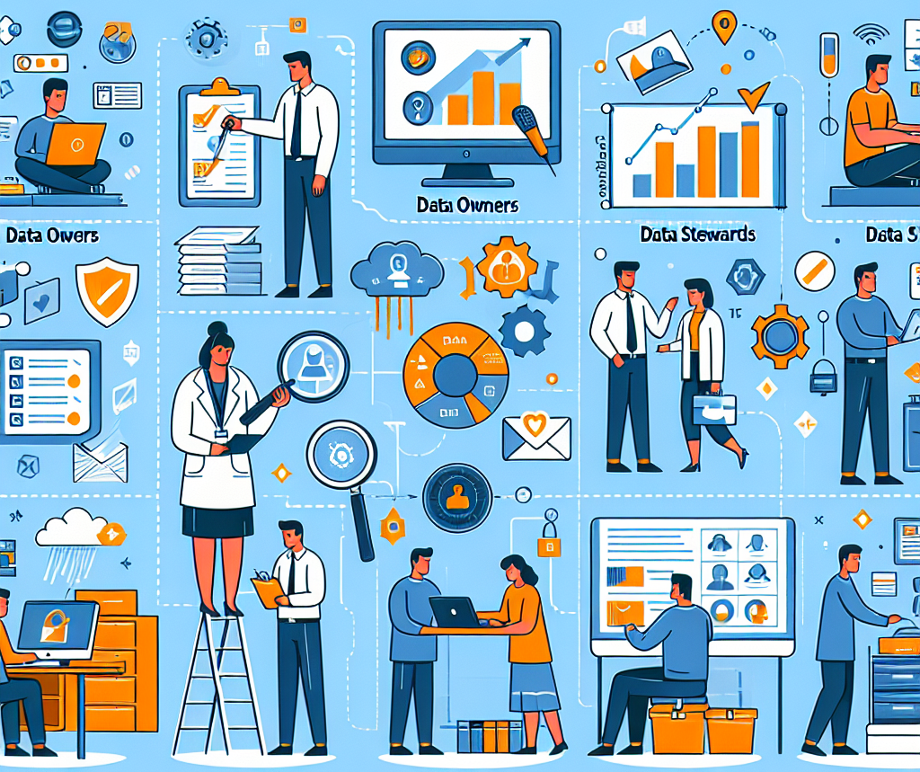
Research Data Management (RDM)
All activities, processes, terms, persons which have relationships with data
Processing
Storage
Organisation
Publication
…
In routine: working with data

Slide 5
RDM Life Cycle
Plan
Processes are ideally cyclic
Reuse
Acquire
Archive
Process / analyse
Publish
Adaptiert von: https://forschungsdaten.info/themen/informieren-und-planen/datenlebenszyklus/

Slide 6
RDM Life Cycle
Plan
Cost
Benefit
Quality
Strategic decisions
Reuse
Acquire
Archive
Process / analyse
Publish
Adaptiert von: https://forschungsdaten.info/themen/informieren-und-planen/datenlebenszyklus/

Slide 7
RDM Life Cycle
Plan
Types of data
Terms and conditions
Usage rights
Copyright
IT infrastructure
Backup
Reuse
Acquire
Archive
Process / analyse
Publish
Adaptiert von: https://forschungsdaten.info/themen/informieren-und-planen/datenlebenszyklus/

Slide 8

Types of data
Structured data
Tables, databases
Unstructured data
Texte, emails, videos, pictures
Semi-structured data
Frageboegen
Scientific images

Slide 9
Types of data
Openly accessible data
„open data“
„open source“ software
Business data
Research data
Hot / cold
Personal data
Secret data
In need of protection (schutzbedürftig)

Slide 10
RDM Life Cycle
Plan
Right to publish
Regulatory aspects
Research data: archive 15 years
Authorship
Registration (-> Findable)
Reuse
Acquire
Archive
Process / analyse
Publish
Delete
Adaptiert von: https://forschungsdaten.info/themen/informieren-und-planen/datenlebenszyklus/

Slide 11
RDM Life Cycle
Plan
Potential future benefit
Sustainability
Important: Licensing
Has impact on next cycle / acquisition
Reuse
Acquire
Archive
Process / analyse
Publish
Adaptiert von: https://forschungsdaten.info/themen/informieren-und-planen/datenlebenszyklus/

Slide 12
What is good RDM?
Clearly defined responsibilities and processes (Governance)
Data Management Plan (DMP)
Communication of goals, metrics, responsibilities, processes
Dedicated personnel
“Data maintainers”
IT infrastructure maintainers
Expert consultants
“Data stewards”
Institution
Department A
Data maintainers
Data Stewards
Department B
Data maintainers

Slide 13
Roles != Job profiles
Domain specialist
Focuses on scientific question, often related to the physical world
Requires sound insights and sustainable solutions
Examples:
Biologist
Geologist
City planner
Data analyst
Focuses on methods for data processing / visualization
Gains sound insights
Examples:
Statistician
Bioinformatician
Data Scientist
IT specialist
Focuses on IT infrastructure
Hardware
Software
Builds sustainable solutions
Examples:
Computer scientist
IT specialist

Slide 14
Data Management Plans (DMPs)
Describes the IS-state of a data environment
Which data is acquired / processed? (content, format, amount)
What meta-data is collected?
Which quality standards are targeted?
How is data saved, archived, backed-up, shared, published…?
Who is responsible for what?
Roles, job-profiles
What does this all cost? (IT infrastructure + human resources)

Slide 15
Data Management Plans (DMPs)
Define responsibilities and procedures early!
Open Science
Experiment design
Imaging / data acquisiton
Data Analysis
Paper writing
“Data / materials we produce will be published under CC-BY 4.0”
Only if procedures are defined early, everyone can follow them.
Licenses are important when assembling materials (-> Copyright)
Meta-data might have higher quality if the person responsible for publishing the data is aware of their duties.
Are we going to publish data / materials / code?
What license can we use?
“Robert will do this by end of 2025!”
Deciding by the end of the project is too late!
DMP

Slide 16
Quiz
Regularly copying files to a remote place is …
Archiving
Backup

Slide 17
Quiz
Data Scientists is a …
Role
Job profile

Slide 18
Quiz
Data Steward is a …
Role
Job profile

Slide 19
Sharing & licensing
Slides
Code
Text
Data
…
Robert Haase

Slide 20
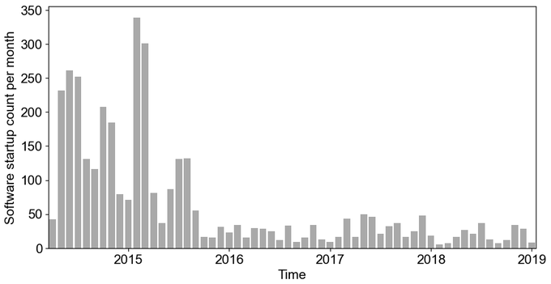
Sustainability of my contribution to science
What happens to research software once the PhD student leaves the institute / field?
(n=1)
PhD student finishes and leaves the institute

Slide 21
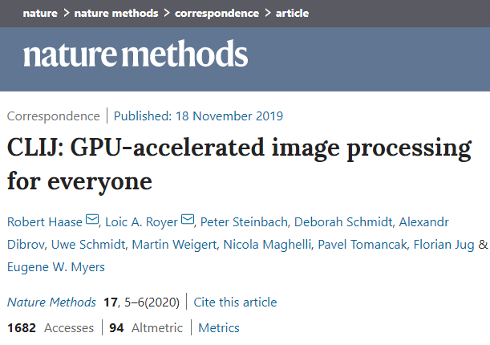
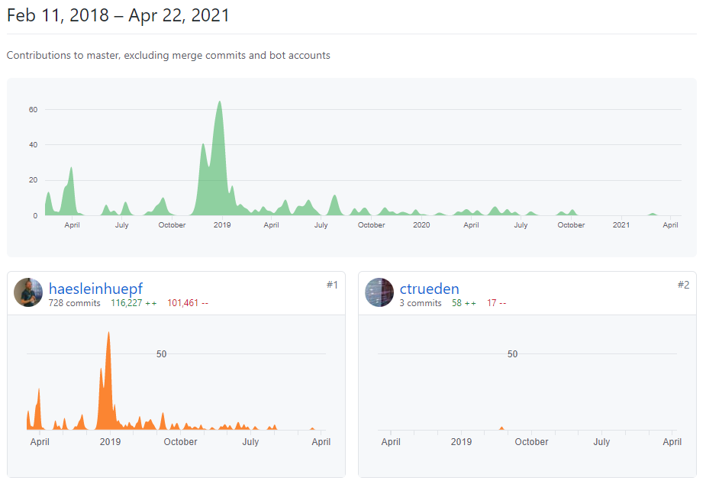

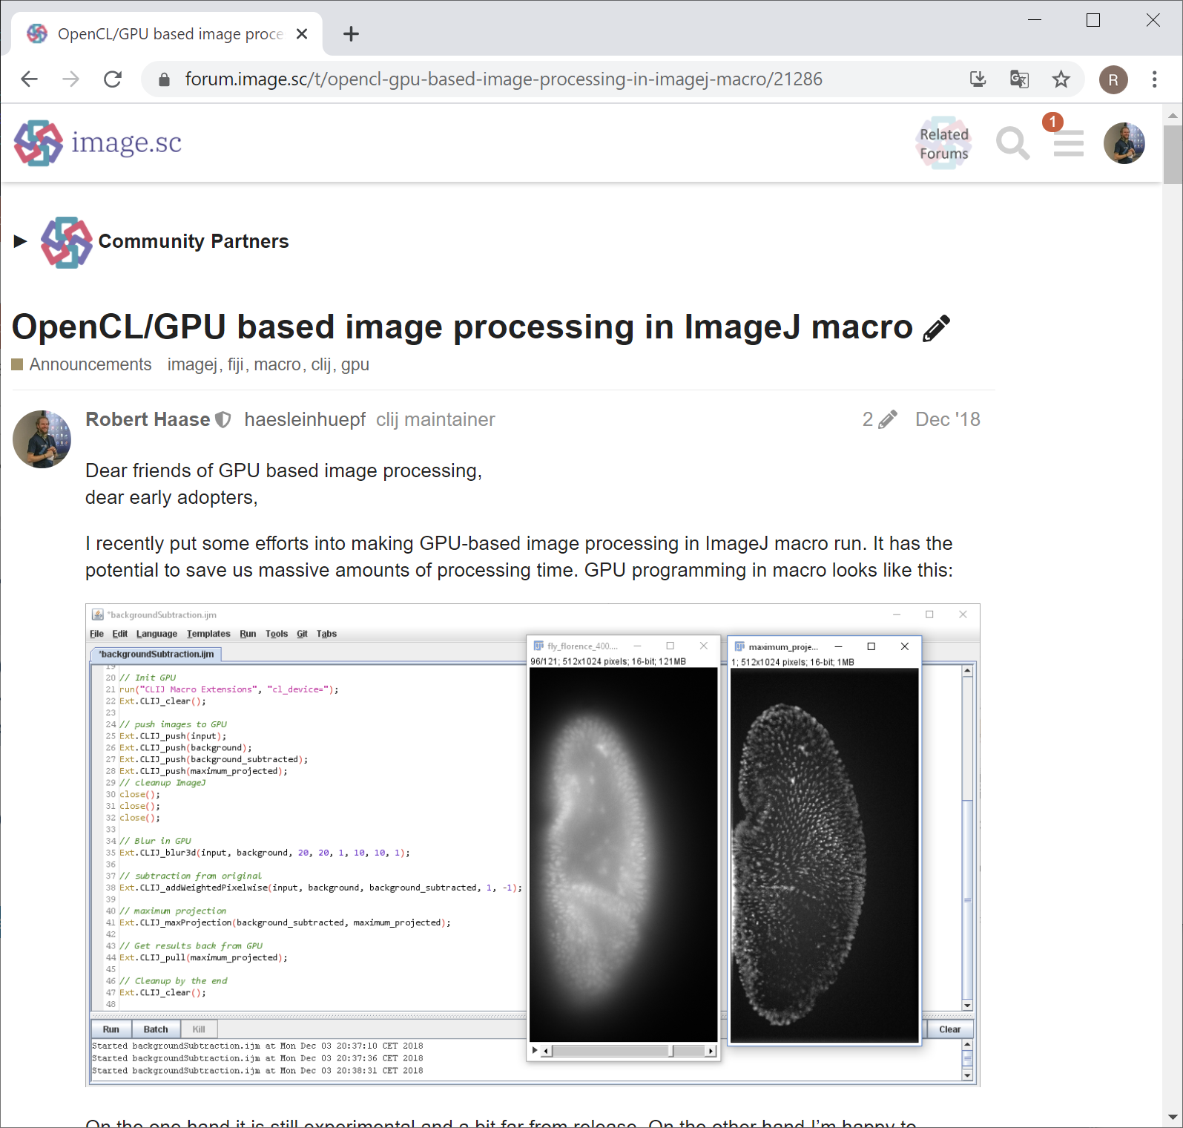
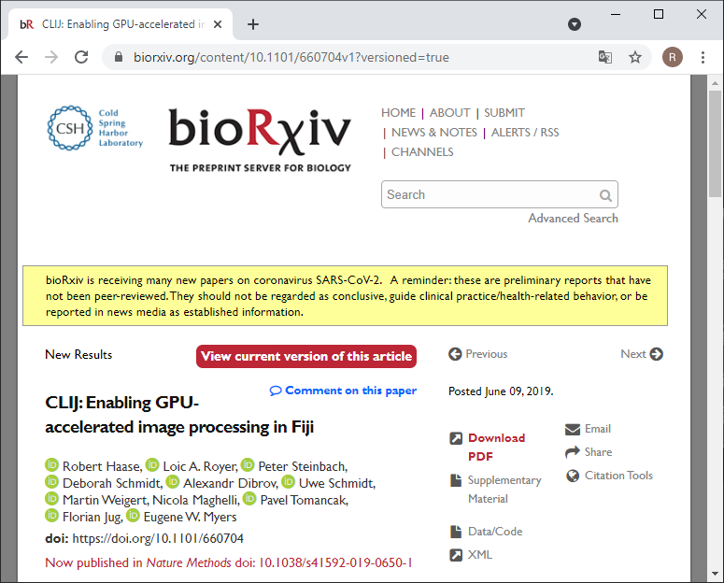
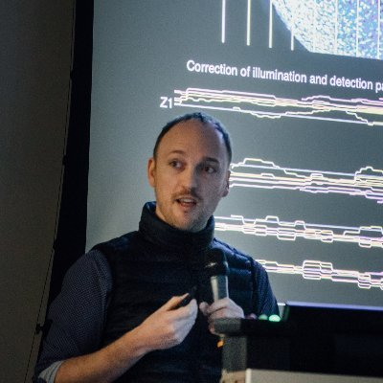
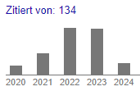
Developing software in the open
2019
2020
2021
Nov. 2017: I took over microscopy control software from Loic and “found” some GPU-accelerated image processing in there
Today: 134 citations
(Google scholar, 2024-03-18)
Loic A. Royer
(CZ Biohub)
@loicaroyer
https://github.com/clij/clij/graphs/contributors https://forum.image.sc/t/opencl-gpu-based-image-processing-in-imagej-macro/21286 https://www.biorxiv.org/content/10.1101/660704v1?versioned=true https://www.nature.com/articles/s41592-019-0650-1

Slide 22

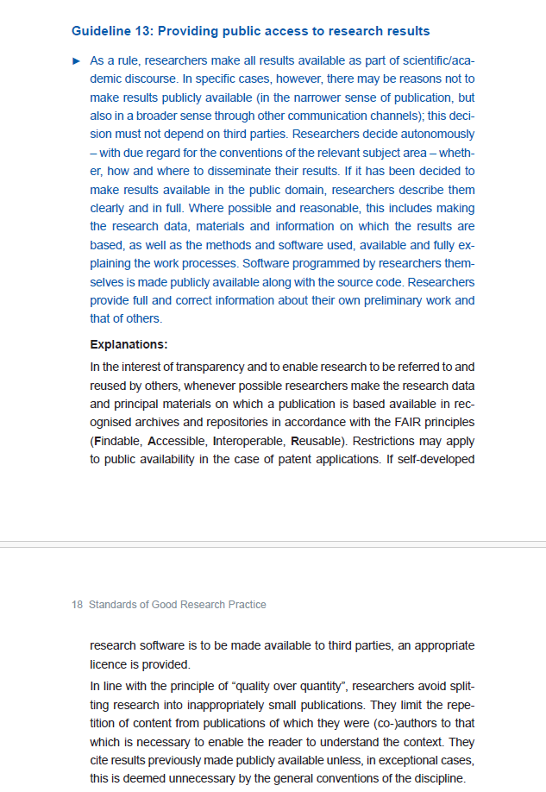
Scientific culture
Public access to research results -> Reusability
“Kodex”
https://www.dfg.de/resource/blob/174052/1a235cb138c77e353789263b8730b1df/kodex-gwp-en-data.pdf

Slide 23
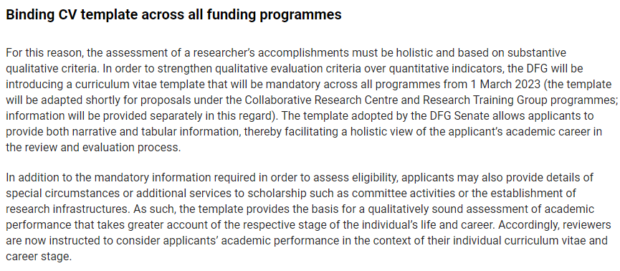

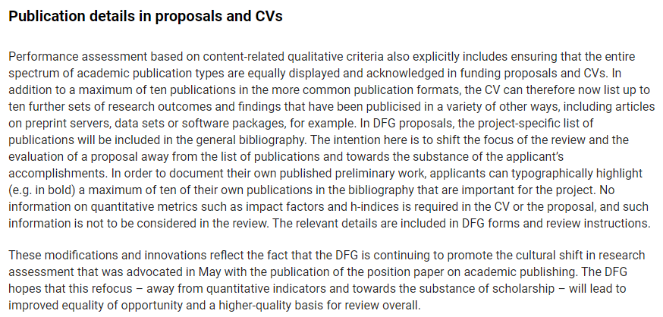
Scientific culture
https://www.dfg.de/en/news/news-topics/announcements-proposals/2022/info-wissenschaft-22-61

Slide 24
Am I allowed to publish my stuff?
… it depends… on who is responsible
Do the work!
The work / product
World
Copyright holder,
e.g. employer
of the author
Author
Creator of the work
Publisher
The person who made
the work available
Licensee
The person who uses / reuses the material

Slide 25
Am I allowed to publish my stuff?
… it depends… on what materials served as basis
Sharing privately
?
Document with unclear copyright
Publish
Author of related material
Licensee / author of derived material

Slide 26
Am I allowed to publish my stuff?
… it depends… on what materials served as basis
Sharing privately
Document with defined copyright
Publish
World
Author of related material
Licensee / author of derived material
Licensee / author of derived material

Slide 27
Openness of software / projects
Closed source
Open source
Benevolent
dictatorship
Community driven
Openly extensible
8
x=1/y
z=y+1
x=1/y
x=1/y
z=y+1
x=1/y
z=y+1
z=y+1
Open to collaborations
“Black box”
Compiled code (e.g. C/C++)
Good for protecting intellectual properties ($$$)
Code available to read
Not necessarily executable code
No maintenance / support efforts
Open to contributions
Single maintainer, often overwhelmed
Efficient decision making
Bus factor ≈1
Open to contributions
Partially democratic
Board of maintainers (core developers)
Long-winded decision making
Openly extensible; without maintainers involved
Partially community driven
Hardware device drivers
Custom image analysis scripts
TrackMate, SNT, MorpholibJ, CLIJ
scikit-image, scipy, OpenCL
ImageJ, Python, numpy
Read more: https://coiled.io/blog/stages-of-openness/

Slide 28
Quiz
What is the role of Github in the context of publishing open-source code?
Copyright holder
Author
Publisher
Licensee

Slide 29

Standard for sharing: The FAIR-principles
Findable
Accessible
Interoperable
Reusable

Slide 30
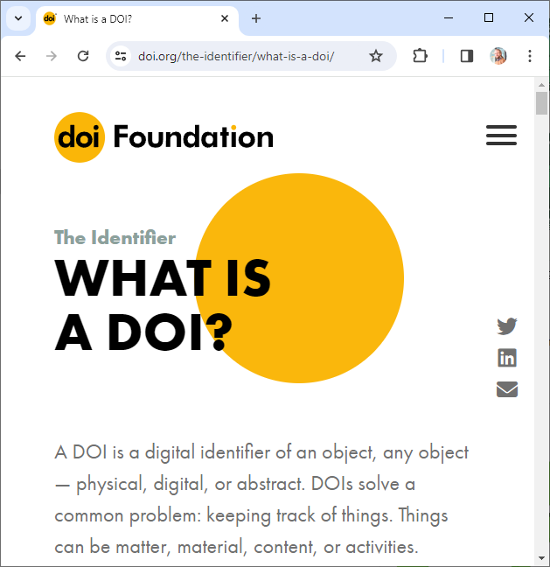
The FAIR-principles
Findable
F1. (Meta)data are assigned a globally unique and persistent identifier
Universal Resource Identifier (URI)
Digital Object Identifier (DOI)
F2. Data are described with rich metadata (defined by R1 below)
F3. Metadata clearly and explicitly include the identifier of the data they describe
F4. (Meta)data are registered or indexed in a searchable resource
Screenshot source: https://www.doi.org/the-identifier/what-is-a-doi/ licensed CC-BY 4.0
https://www.go-fair.org/fair-principles/
https://biii.eu/introduction-3d-analysis-3d-imagej-suite

Slide 31
Meta data
Generic
Author
Usage license
Creation date
Field-specific (microscopy)
Exposure time
Wavelength (colour)
Microscope type/vendor
Goals:
FAIR+
Reproducibility

Slide 32
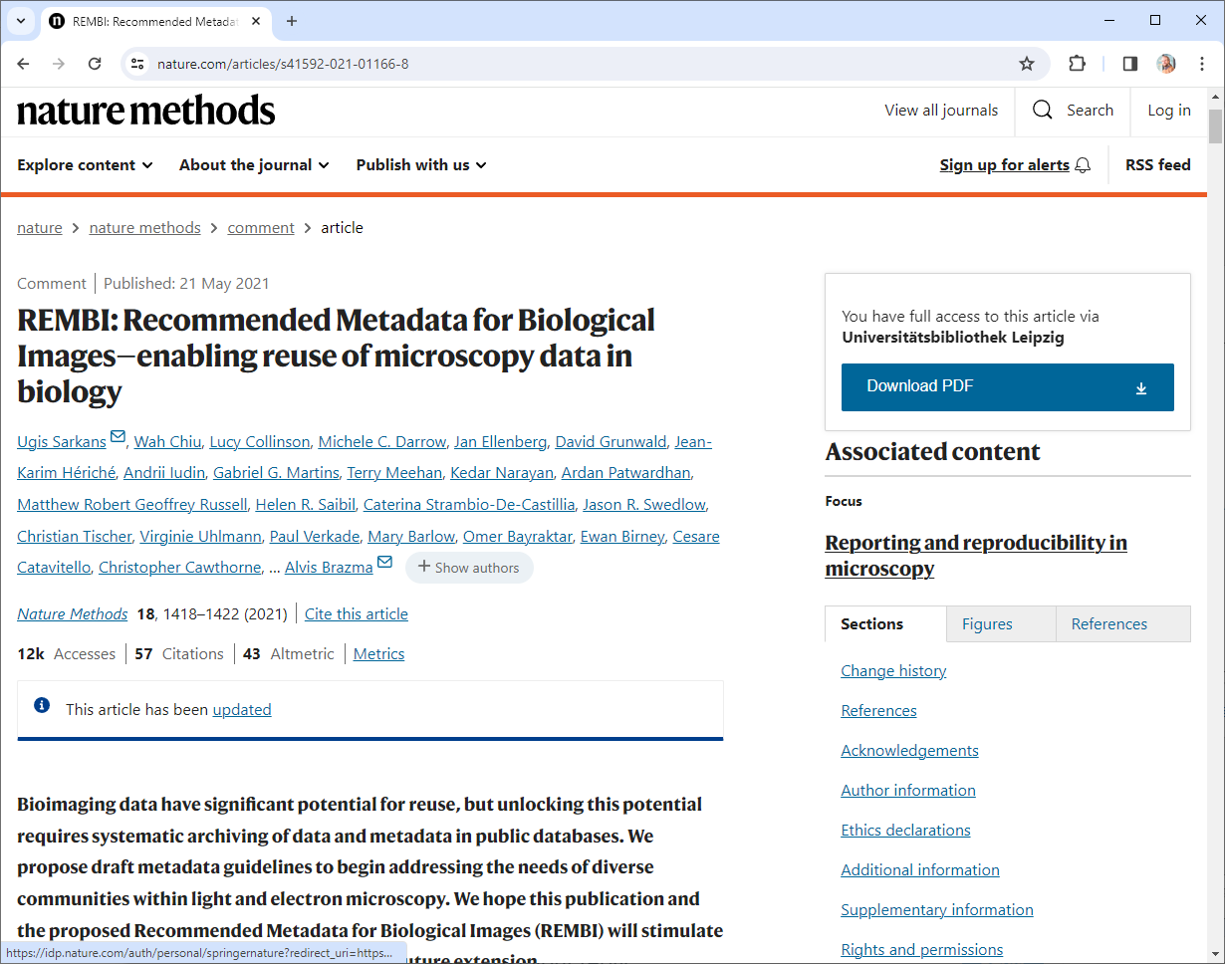
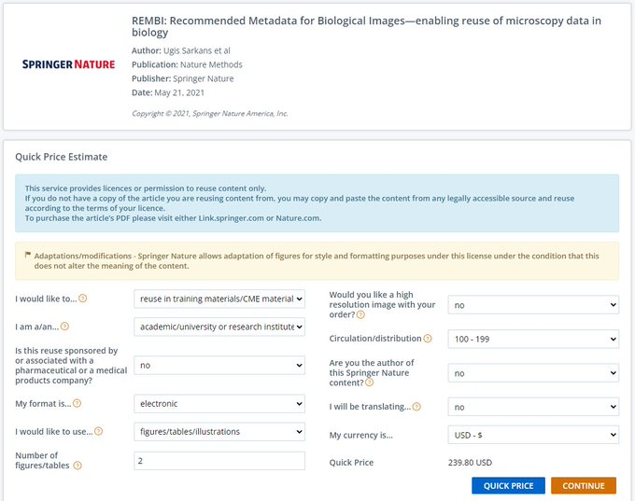
REMBI: Recommended Metadata for Biological Images—enabling reuse of microscopy data in biology
Read more:
https://www.nature.com/articles/s41592-021-01166-8

Slide 33
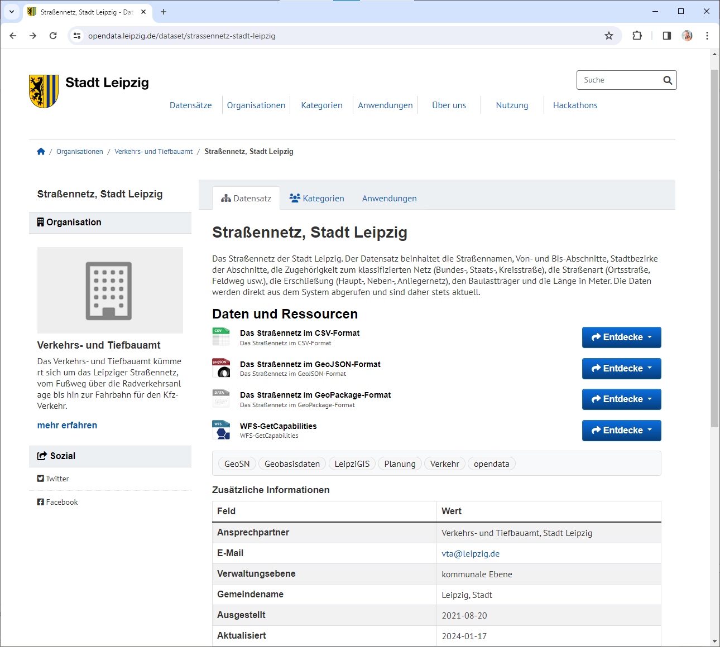
Digital Object Identifiers (DOI)
DOIs / URIs always point at the same data
DOIs are centrally registers, URIs not
Unified Resource Locators (URLs) may point at different things
This no DOI, no URI, it’s a URL
https://opendata.leipzig.de/dataset/strassennetz-stadt-leipzig

Slide 34
Unified Resource Identifiers
Which of these are URIs?
https://twitter.com/haesleinhuepf/status/891596662782779392
https://doi.org/10.5281/zenodo.28325
https://opendata.leipzig.de/dataset/vornamenstatistik-2023
https://www.leipzig.de/

Slide 35
Digital Object Identifiers
Which of these are DOIs?
https://twitter.com/haesleinhuepf/status/891596662782779392
https://doi.org/10.5281/zenodo.28325
https://opendata.leipzig.de/dataset/vornamenstatistik-2023
https://www.leipzig.de/

Slide 36
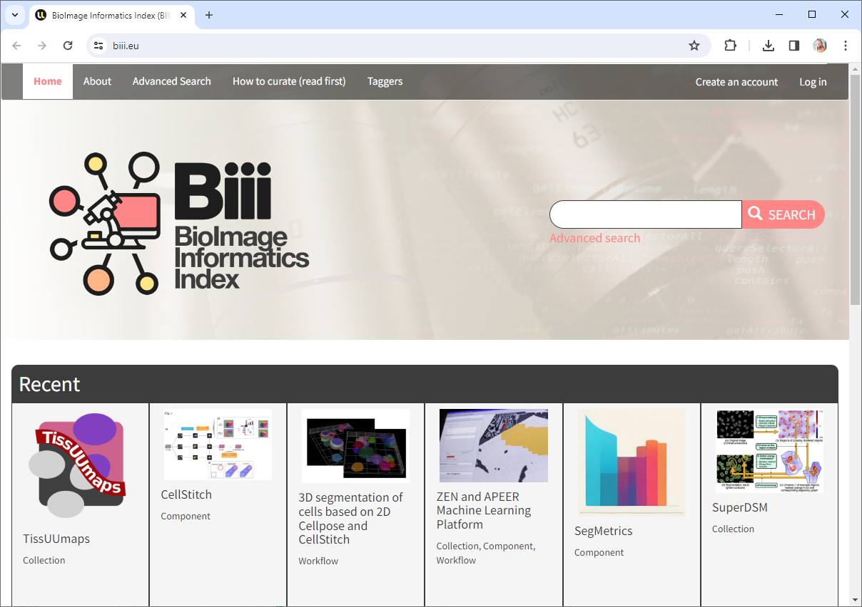
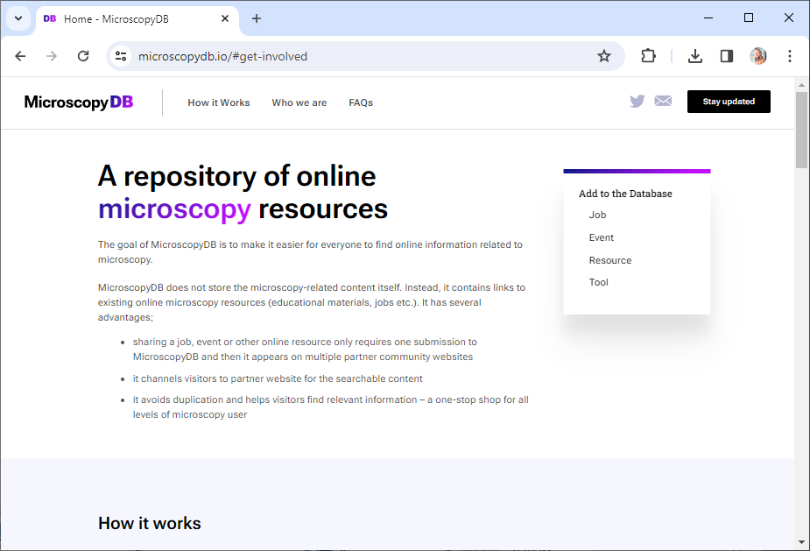
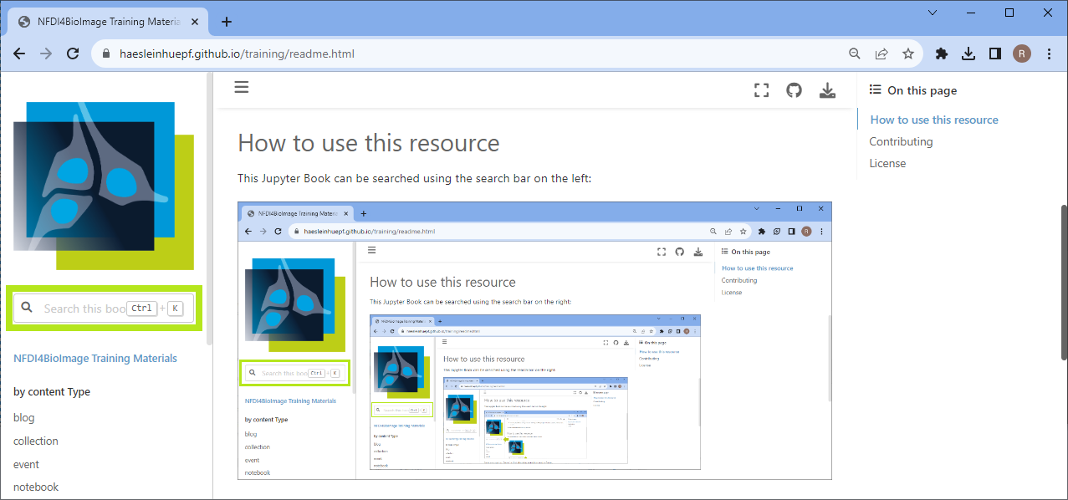
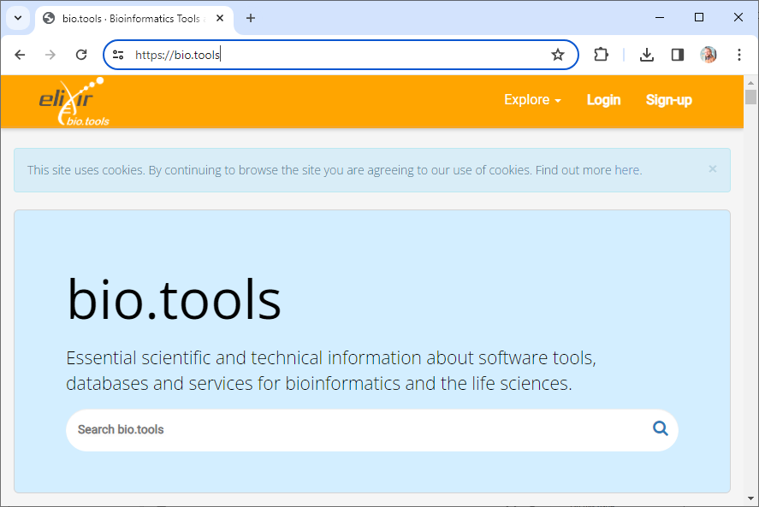
Indexing
Make sure your materials are listed in public search indices
Do not trust google to make your stuff findable
https://biii.eu/ https://bio.tools/ https://microscopydb.io/#get-involved https://nfdi4bioimage.github.io/training

Slide 37
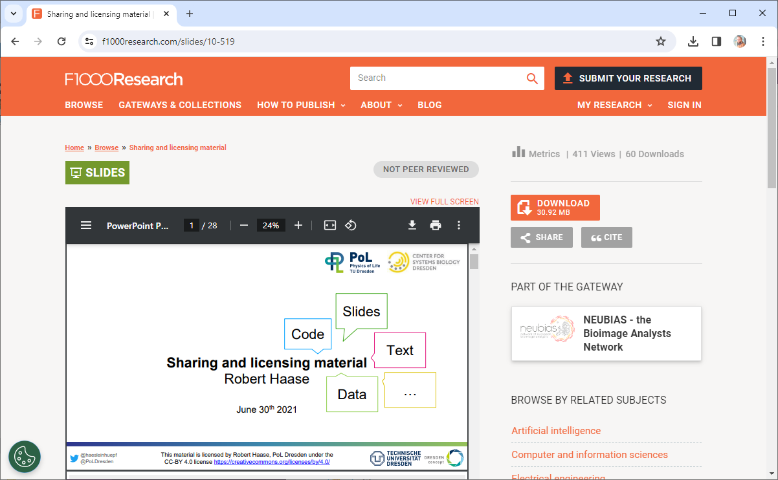
Incentives: Findability
Your future-self will thank you, because they will find your work
You remember that talk you gave in 2021?
Where are the slides?
Online, open access!
https://f1000research.com/slides/10-519

Slide 38
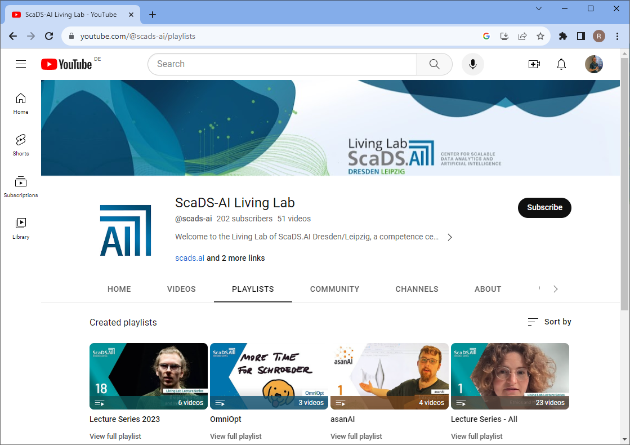
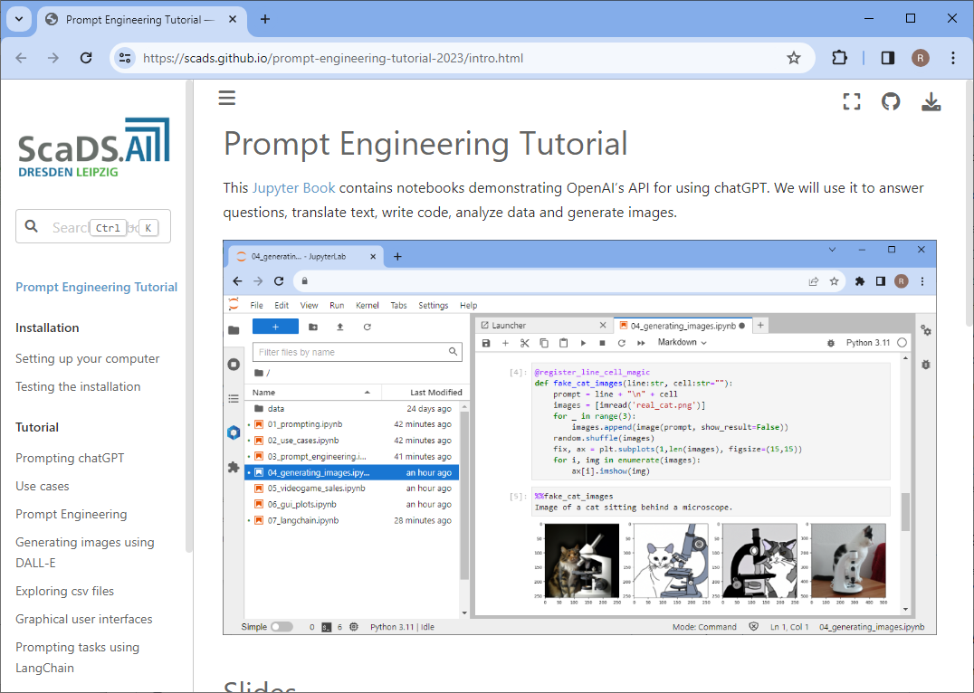
Incentives: Findability -> Visibility
YouTube
Github
Open & FAIR sharing is a PR instrument
… leading to
more software users
new collaborations
https://www.youtube.com/@scads-ai
https://scads.github.io/prompt-engineering-tutorial-2023

Slide 39

The FAIR-principles
Accessible
A1. (Meta)data are retrievable by their identifier using a standardised communications protocol
A1.1 The protocol is open, free, and universally implementable
A1.2 The protocol allows for an authentication and authorisation procedure, where necessary
A2. Metadata are accessible, even when the data are no longer available
https://www.go-fair.org/fair-principles/
Comic taken from https://xkcd.com/927/ licensed under a Creative Commons Attribution-NonCommercial 2.5 License.

Slide 40
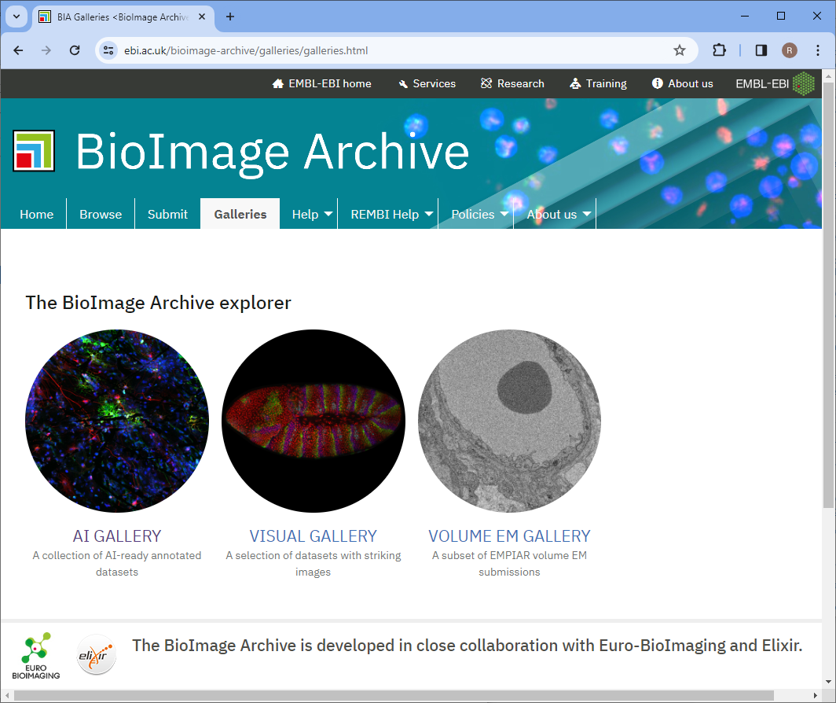
Accessibility
The ability to download data, for humans and computers
Essential for AI developers =-)
https://www.ebi.ac.uk/bioimage-archive/galleries/galleries.html

Slide 41
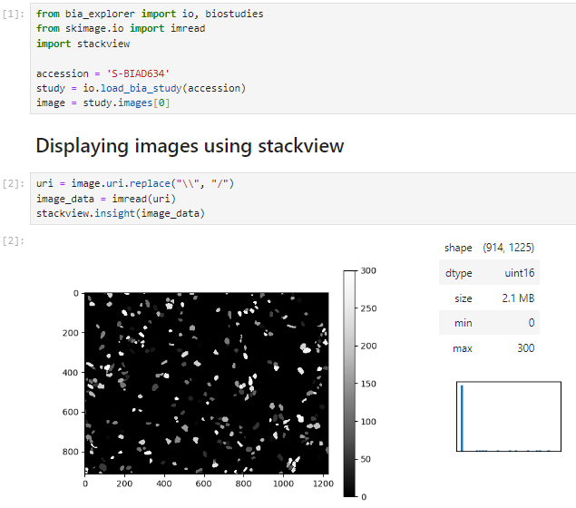
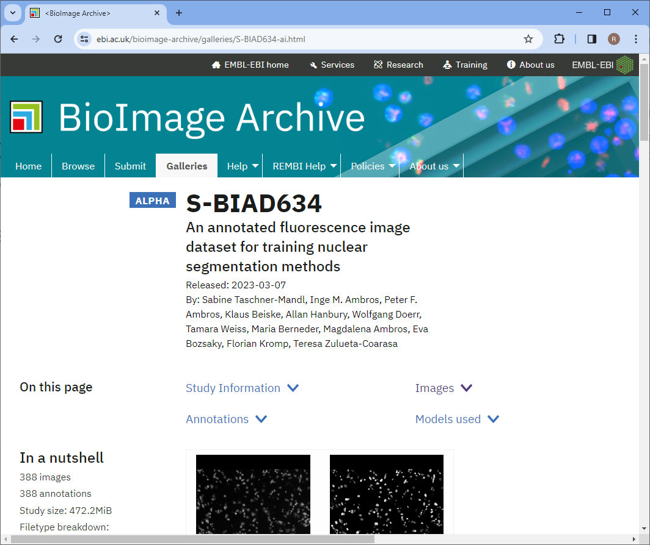
Accessibility
The ability to download data, for humans and computers
https://www.ebi.ac.uk/bioimage-archive/galleries/S-BIAD634-ai.html

Slide 42
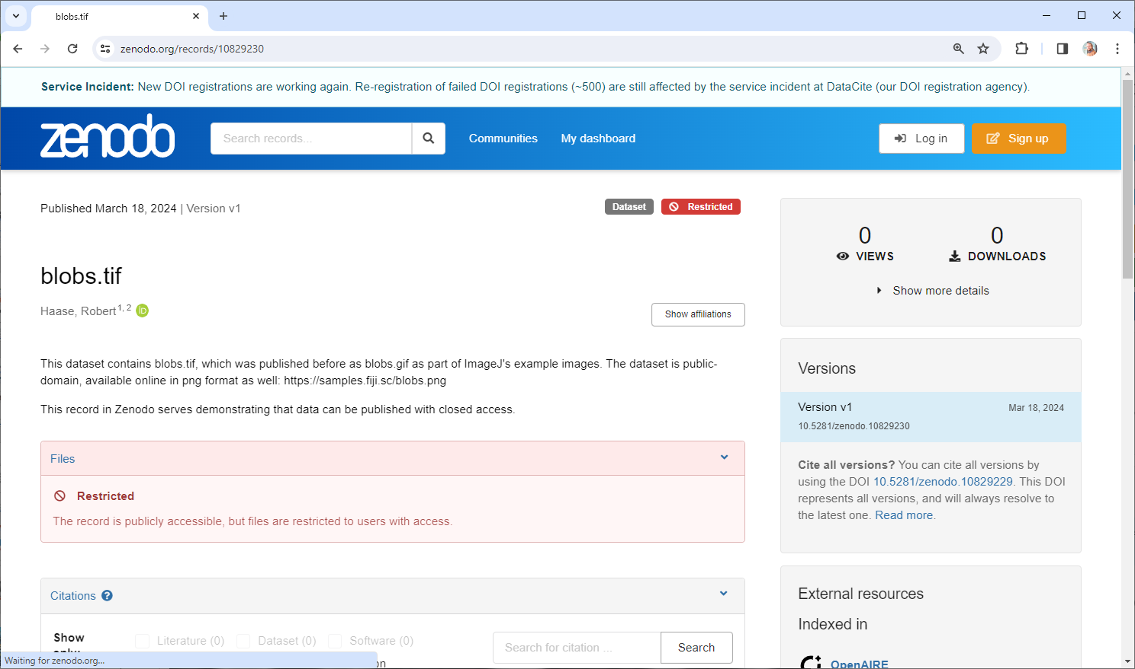
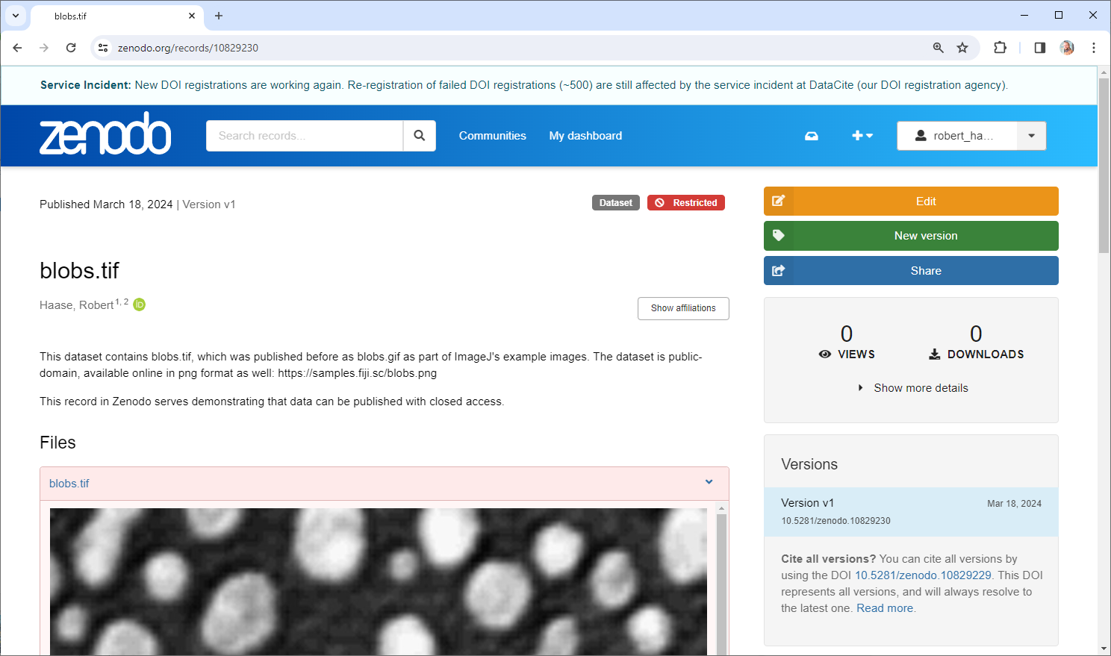
Restricted Access
The A in FAIR does not necessarily stand for Open Access
https://zenodo.org/records/10829230

Slide 43
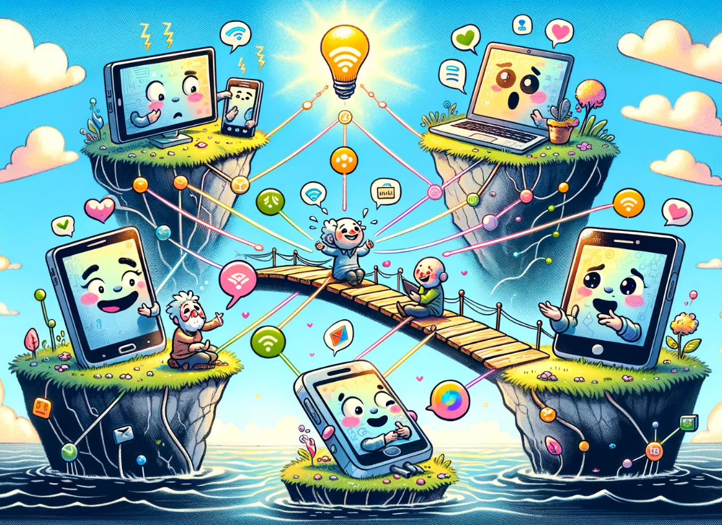
The FAIR-principles
Interoperable
I1. (Meta)data use a formal, accessible, shared, and broadly applicable language for knowledge representation.
I2. (Meta)data use vocabularies that follow FAIR principles
I3. (Meta)data include qualified references to other (meta)data
https://www.go-fair.org/fair-principles

Slide 44


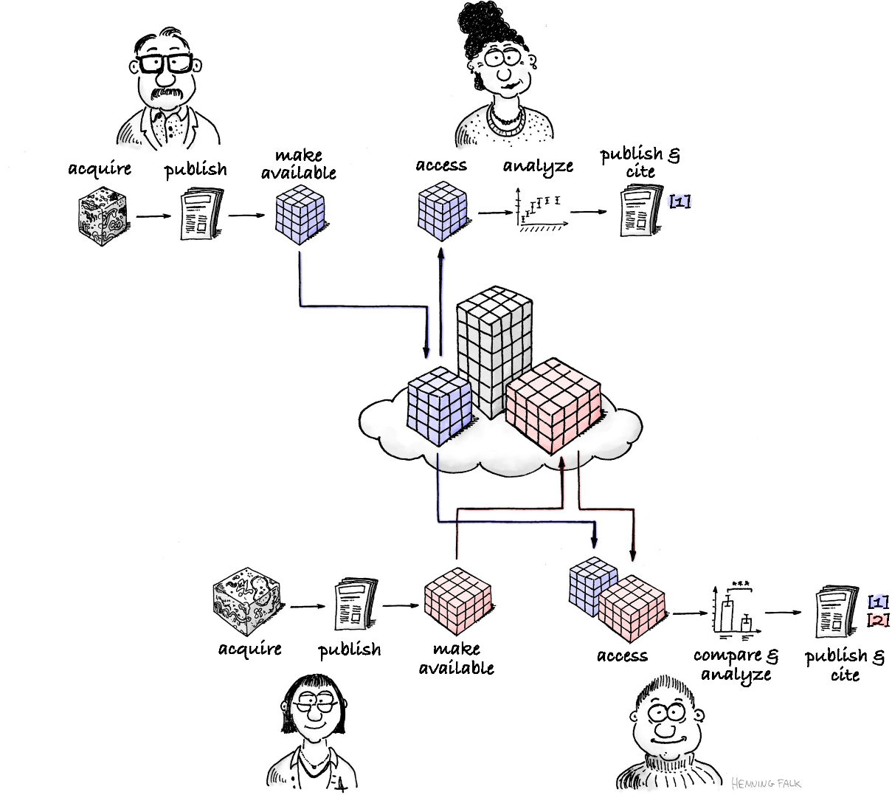
The FAIR-principles
Reusable
R1. (Meta)data are richly described with a plurality of accurate and relevant attributes
R1.1. (Meta)data are released with a clear and accessible data usage license
R1.2. (Meta)data are associated with detailed provenance
R1.3. (Meta)data meet domain-relevant community standards
https://www.go-fair.org/fair-principles/
Drawing made by Henning Falk, ©2022 NumFOCUS, reused under a CC BY 4.0 license

Slide 45
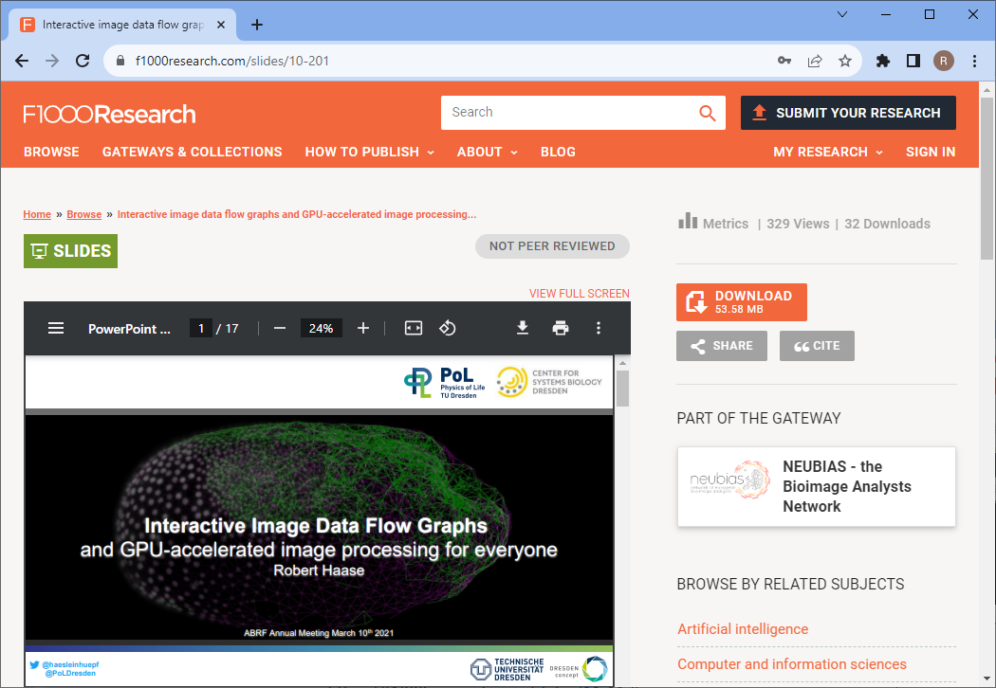
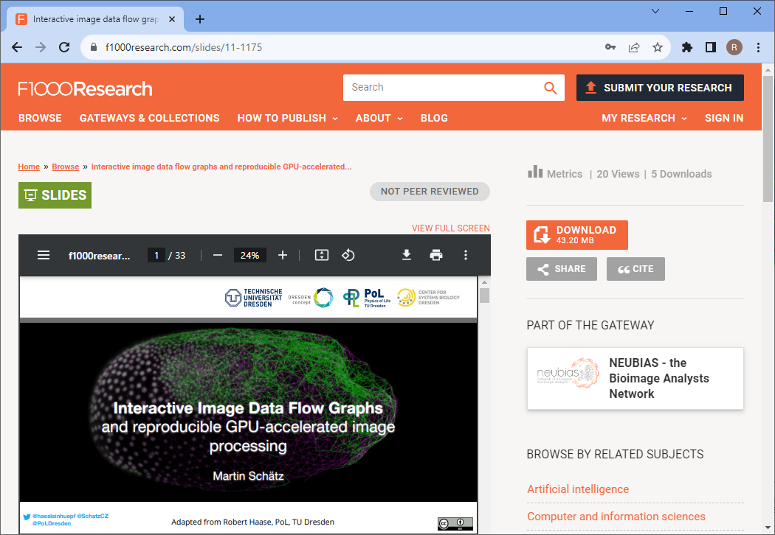
Incentives: Reusability
Open Access -> Others teach how to use your tools & methods
https://f1000research.com/slides/10-201
https://f1000research.com/slides/11-1175

Slide 46
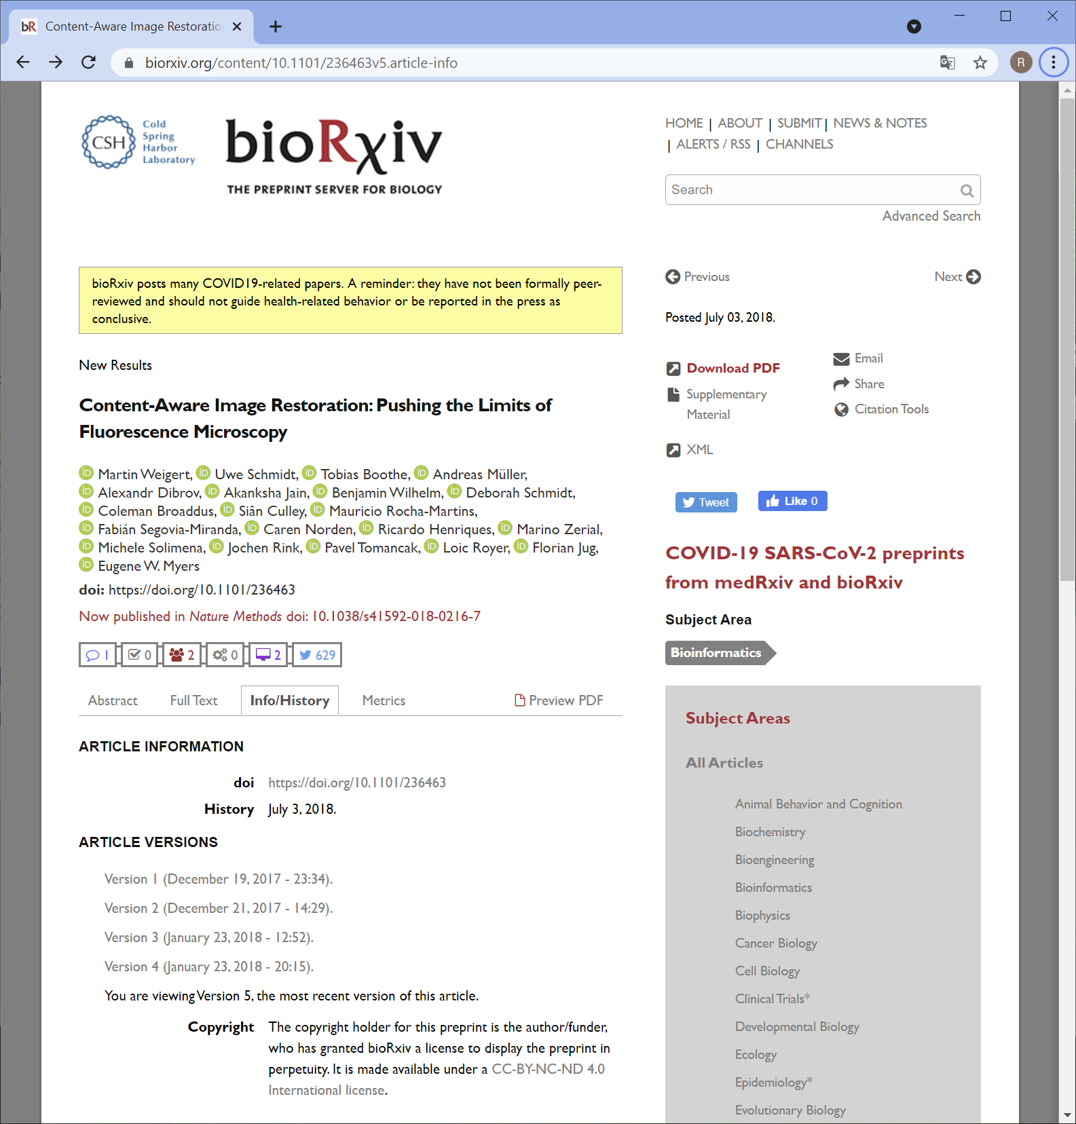
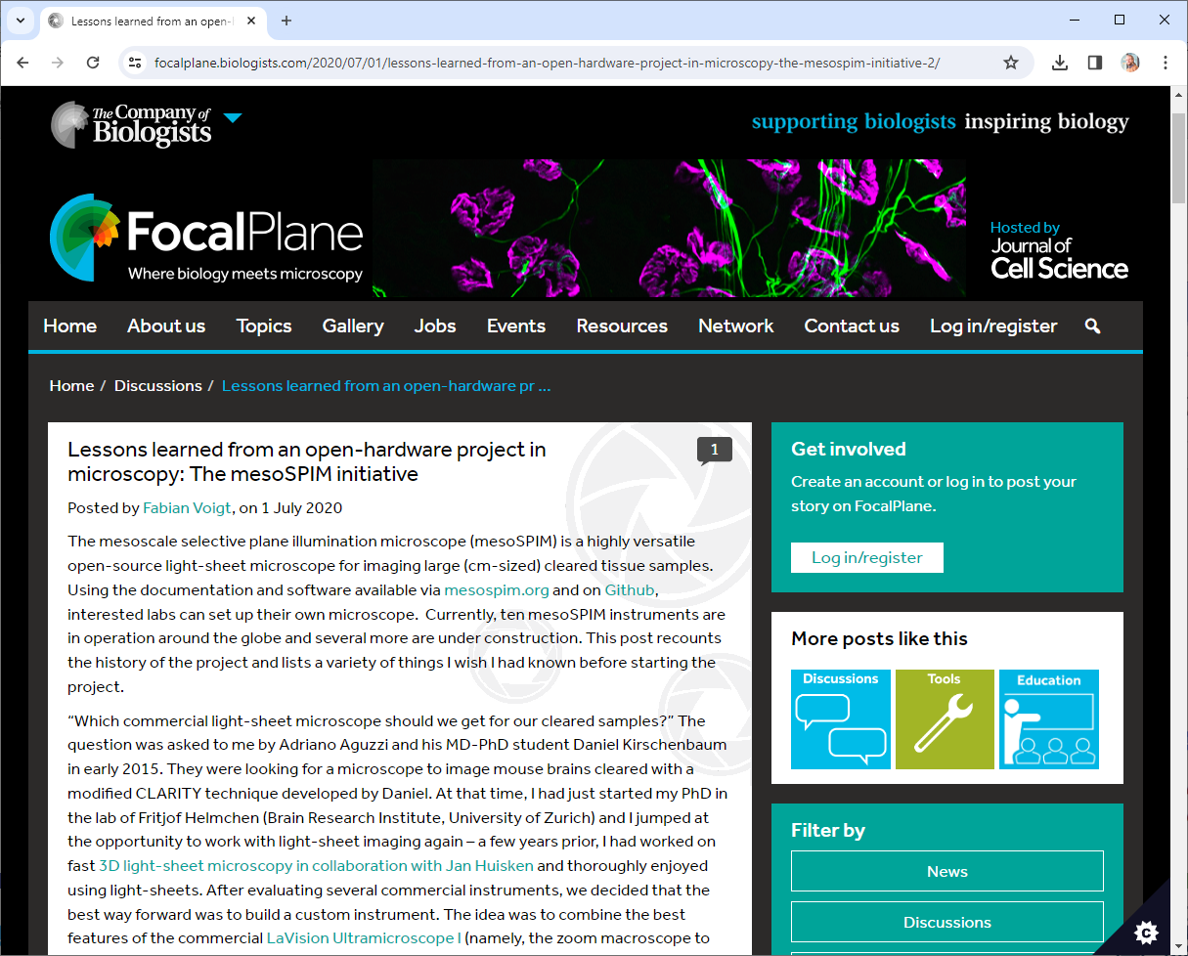
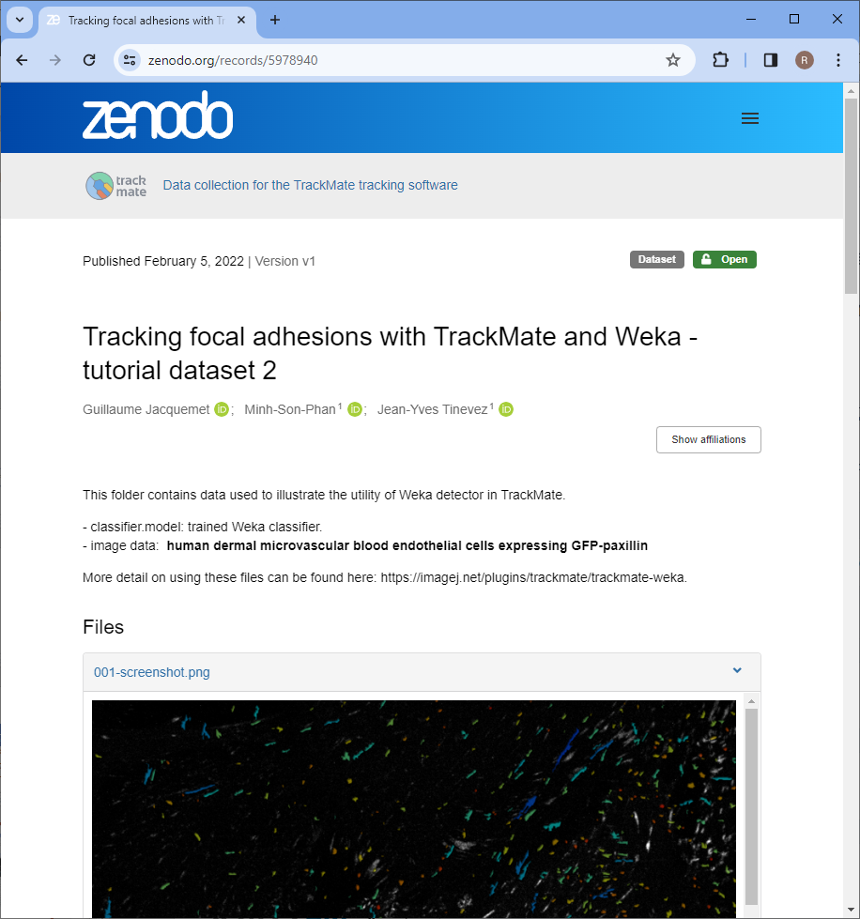
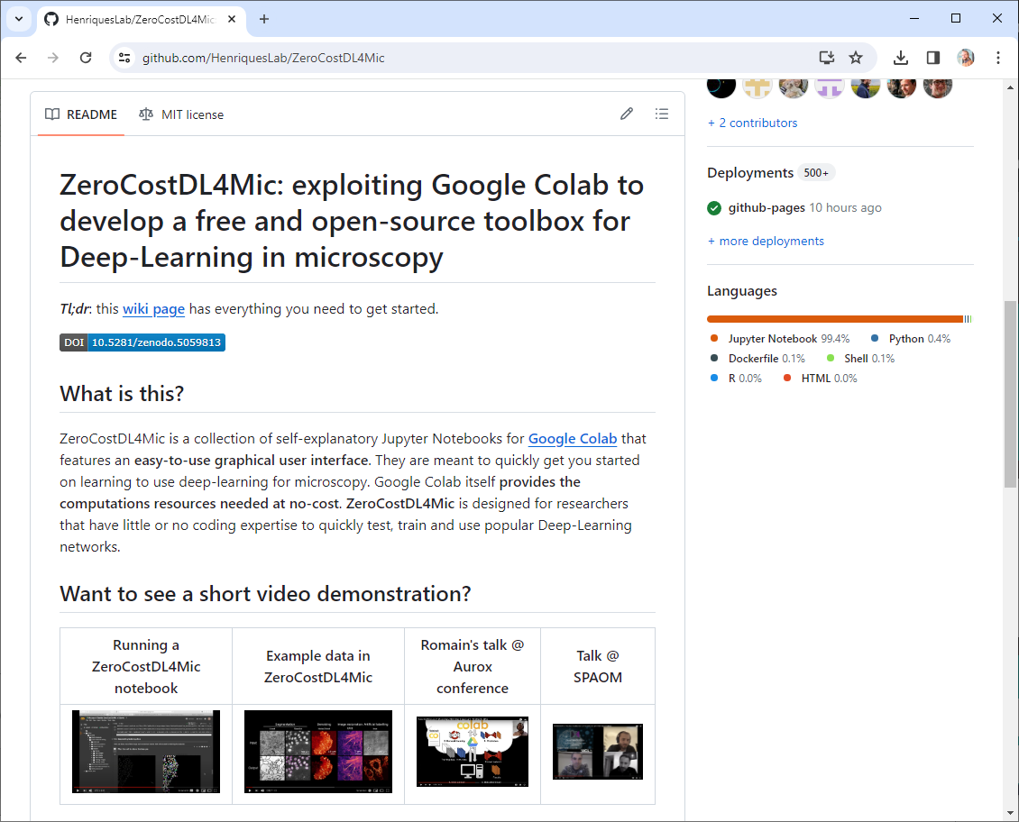
Where to share?
Open science related content
bioRxiv (manuscripts, no reviews)
Figshare
F1000
Bioimage Archive (data)
Github (code)
Zenodo
Focalplane
Institutional servers (if there is no alternative)
https://www.biorxiv.org/content/10.1101/236463v5.article-info https://github.com/HenriquesLab/ZeroCostDL4Mic https://focalplane.biologists.com/2020/07/01/lessons-learned-from-an-open-hardware-project-in-microscopy-the-mesospim-initiative-2/
https://zenodo.org/records/5978940

Slide 47
Quiz
Where might open source code be most visible?
Git server of the university
Zenodo.org
Github.com
Group / institute / personal website

Slide 48
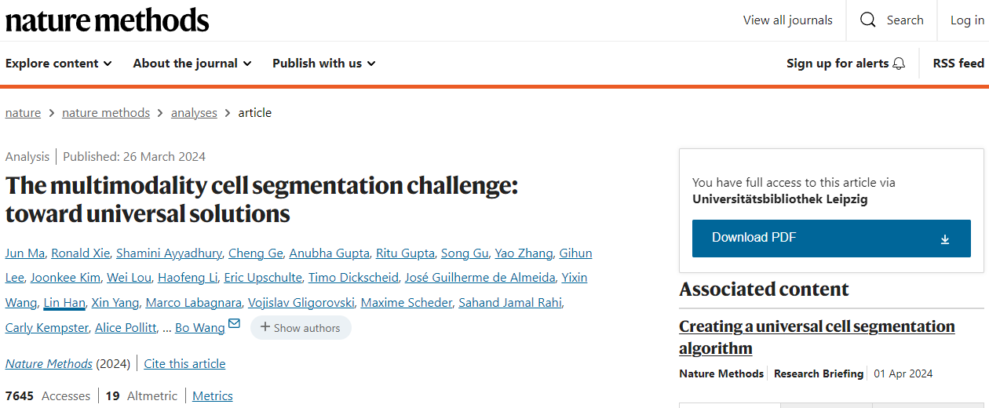
A short excursion…
Published 2 weeks ago:
“The T1 algorithms achieved a median F1 score of 89.7% (IQR 36.7–82.4%), surpassing the KIT-GE, Cellpose-pretrain, Cellpose-scratch, Omnipose-pretrain and Omnipose-scratch by 49.9%, 24.4%, 35.4%, 58.9% and 48.7%, respectively.”
Claim to outperform current state of the art.
Ma, J., Xie, R., Ayyadhury, S. et al. The multimodality cell segmentation challenge: toward universal solutions. Nat Methods (2024). https://doi.org/10.1038/s41592-024-02233-6

Slide 49
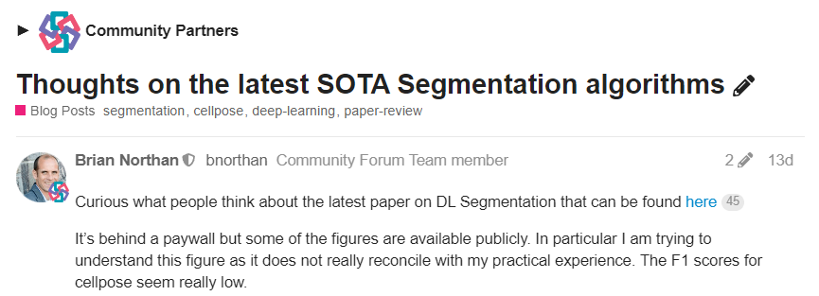
A short excursion…
“However my initial testing of the winning entry mediar 8 reveals errors (which are typical without tuning) when applied to recent data posted here 6 for which cellpose produced a (subjectively) good result.”
Brian Northan et al.
https://forum.image.sc/t/thoughts-on-the-latest-sota-segmentation-algorithms/94106

Slide 50
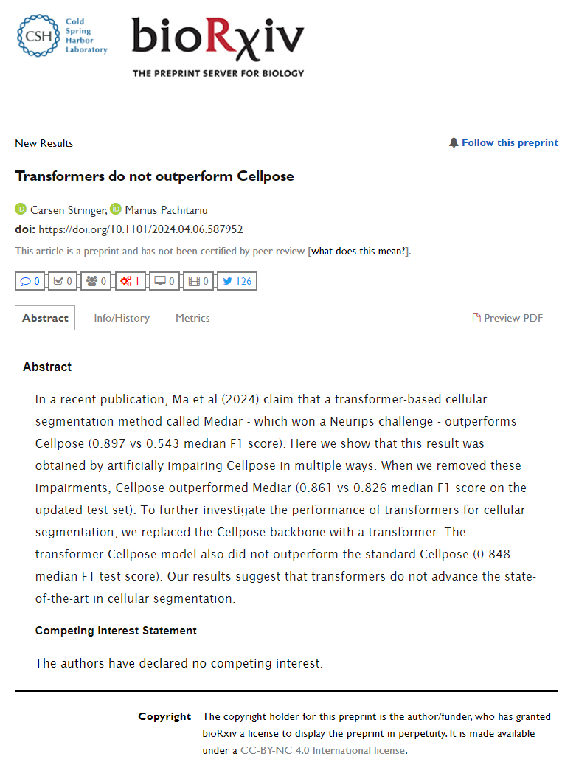
A short excursion…
Published on Sunday: (by the CellPose authors)
“In fact, Mediar directly copied our codebase for implementing the Cellpose framework without modification”
Stringer & Pachitariu, bioRxiv, 2024
https://www.biorxiv.org/content/10.1101/2024.04.06.587952v1

Slide 51
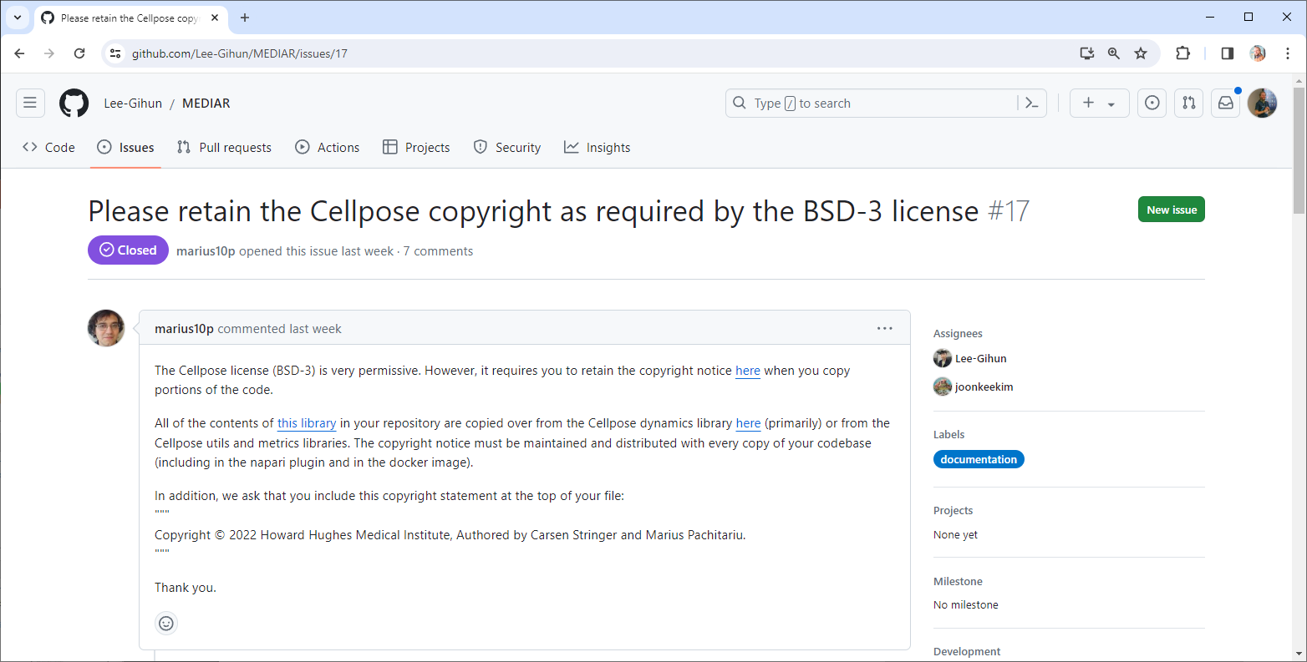
A short excursion…
Professional discussion about Copyright:
https://github.com/Lee-Gihun/MEDIAR/issues/17

Slide 52
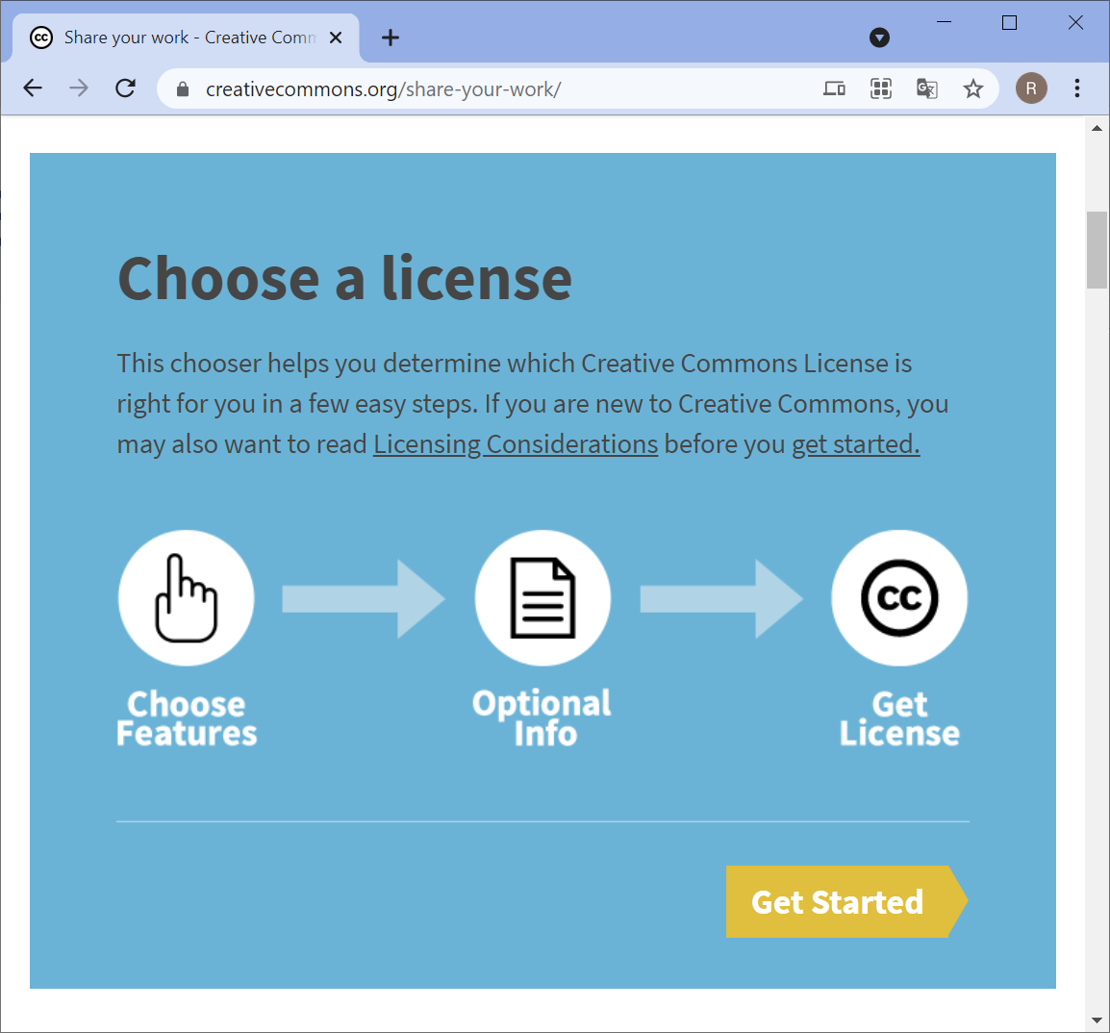
Licensing: Creative Commons (CC)
Public domain (CC0)
Attribution International (CC-BY)
Attribution ShareAlike Int. (CC-BY-SA)
Attribution Non-Commercial Int. (CC-BY-NC)
Attribution NoDerivatives Int. (CC-BY-ND)
+ Combinations, e.g. CC-BY-NC-ND
Content on this site is licensed under a Creative Commons Attribution 4.0 International license. Icons by The Noun Project.
https://creativecommons.org/share-your-work/
https://creativecommons.org/about/cclicenses/

Slide 53

Licensing: Creative Commons (CC)
Public domain (CC0)
Everyone can reuse without mentioning the source or author of the shared resource.
Public domain licenses cannot be revoked.
The author must own the right to copy (copyright) the resource.
If you authored work as part of your job, you may not be the copyright holder. (check your employers' guidelines)
Employers don’t like this one because you give away the rights to exploit you work.
Content on this slide was adapted from https://creativecommons.org/about/cclicenses/ which is licensed under a Creative Commons Attribution 4.0 International license. Icons by The Noun Project.
https://creativecommons.org/share-your-work/
https://creativecommons.org/about/cclicenses/

Slide 54
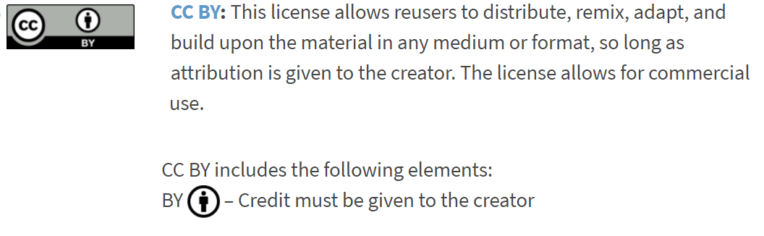
Licensing: Creative Commons (CC)
“By attribution”
Content on this slide was adated from https://creativecommons.org/about/cclicenses/ which is licensed under a Creative Commons Attribution 4.0 International license. Icons by The Noun Project.
https://creativecommons.org/share-your-work/
https://creativecommons.org/about/cclicenses/

Slide 55
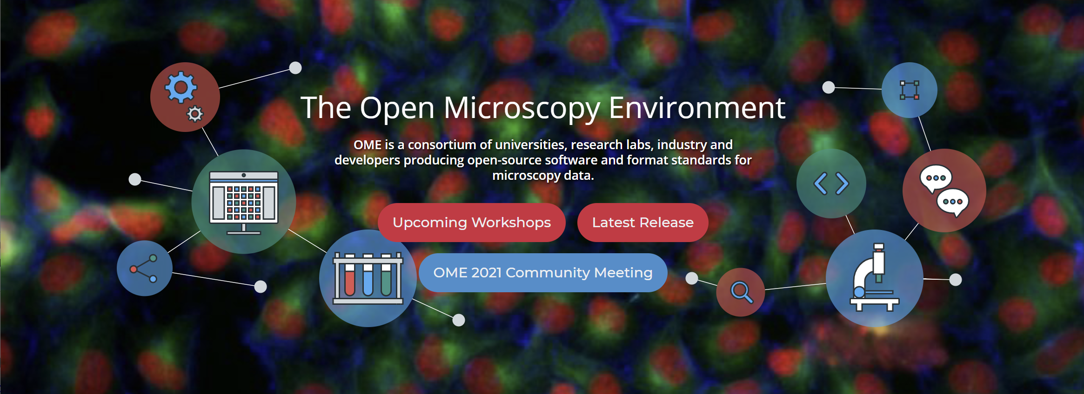
Licensing: Creative Commons (CC)
Example
You must put such a sentence and keep the link to CC-BY
Figure adapted from https://www.openmicroscopy.org/ licensed by University of Dundee & Open Microscopy Environment under Creative Commons Attribution 4.0 International License

Slide 56
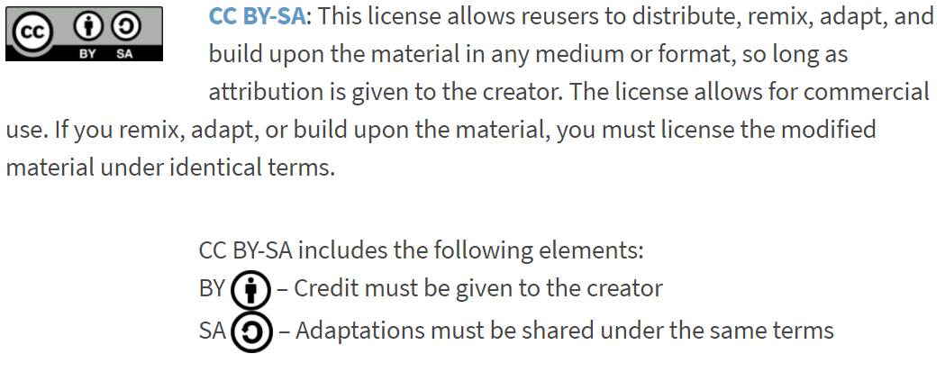
Licensing: Creative Commons (CC)
“Share alike”
“Restrictive” licensing
Content on this slide was adapted from https://creativecommons.org/about/cclicenses/ which is licensed under a Creative Commons Attribution 4.0 International license. Icons by The Noun Project.
https://creativecommons.org/share-your-work/
https://creativecommons.org/about/cclicenses/

Slide 57
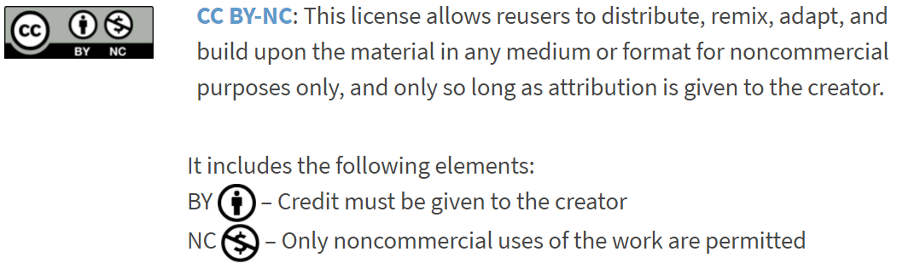
Licensing: Creative Commons (CC)
“Restrictive” licensing
Content on this slide was adapted from https://creativecommons.org/about/cclicenses/ which is licensed under a Creative Commons Attribution 4.0 International license. Icons by The Noun Project.
https://creativecommons.org/share-your-work/
https://creativecommons.org/about/cclicenses/

Slide 58
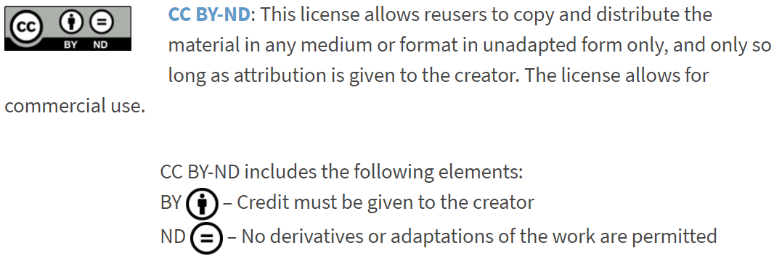
Licensing: Creative Commons (CC)
“Restrictive” licensing
Content on this slide was adapted from https://creativecommons.org/about/cclicenses/ which is licensed under a Creative Commons Attribution 4.0 International license. Icons by The Noun Project.
https://creativecommons.org/share-your-work/
https://creativecommons.org/about/cclicenses/

Slide 59
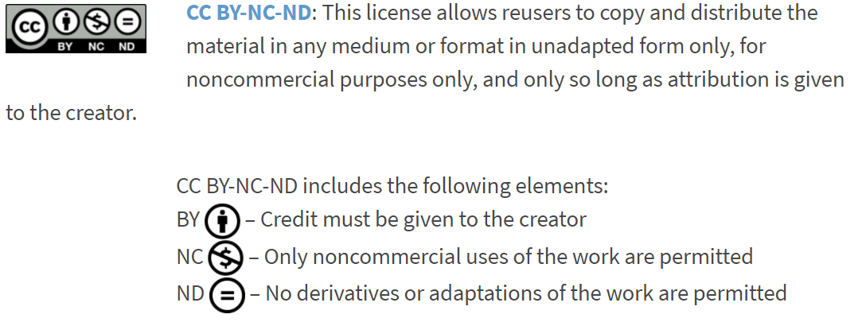
Licensing: Creative Commons (CC)
“Restrictive” licensing
Content on this slide was adapted from https://creativecommons.org/about/cclicenses/ which is licensed under a Creative Commons Attribution 4.0 International license. Icons by The Noun Project.
https://creativecommons.org/share-your-work/
https://creativecommons.org/about/cclicenses/

Slide 60
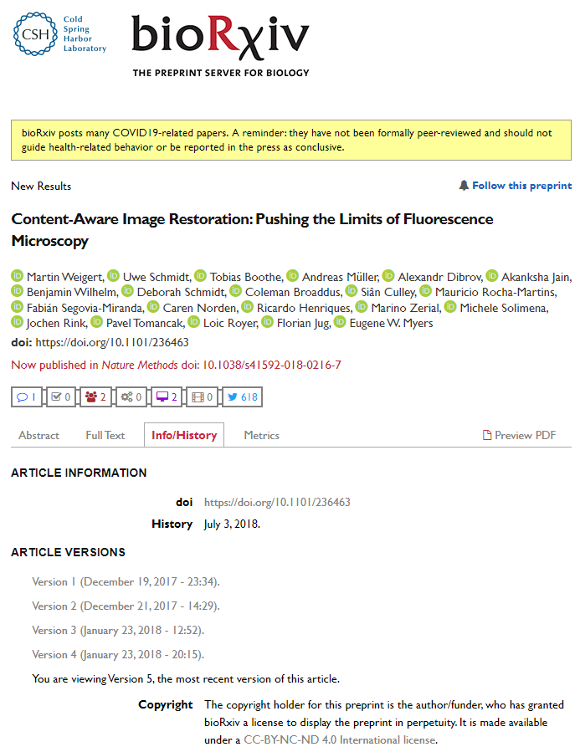
Quiz
May I use one of the Figures from this preprint?
May I download and redistribute this preprint to students of a course for free?
Yes
No
Yes
No

Slide 61
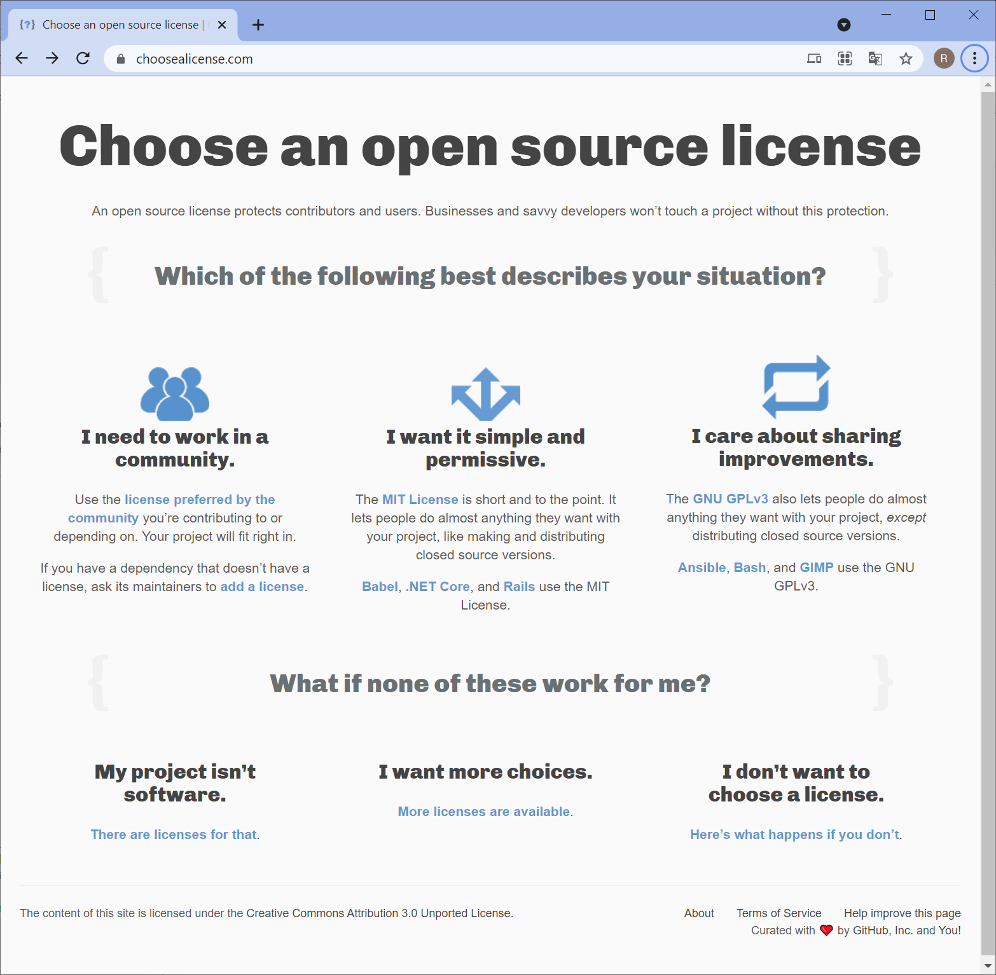
Licensing Software
In the software world, other licenses are more popular, historically grown.
BSD
BSD
GPL
GPL
Apache
Berkley Software Distribution
GNU General Public License
LGPL
MIT
https://choosealicense.com/

Slide 62
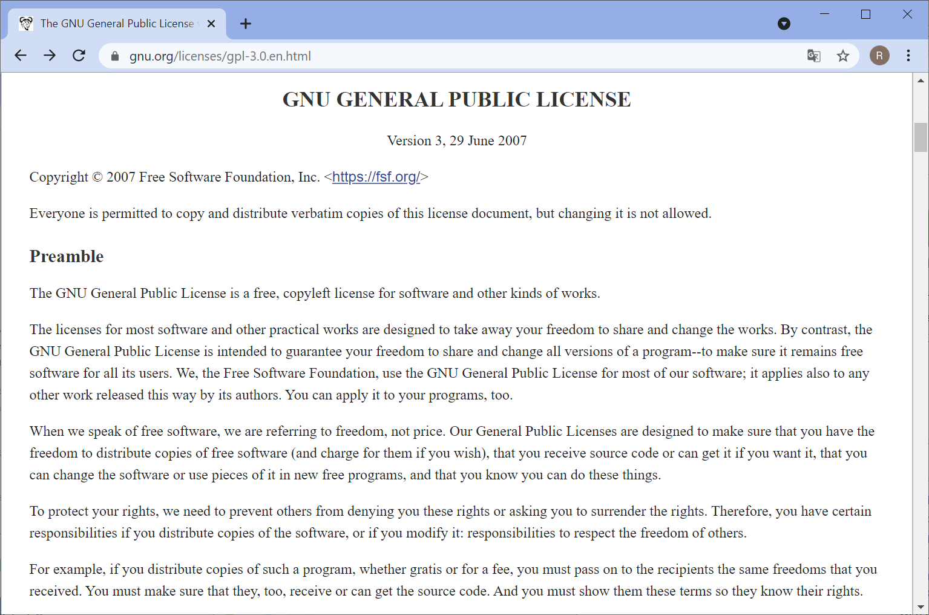
Licensing Software: GPL
GPL-derivatives must also be GPL-licensed
“Restrictive” licensing
https://www.gnu.org/licenses/gpl-3.0.en.html
https://en.wikipedia.org/wiki/GNU_General_Public_License#Copyleft

Slide 63
Quiz
Can I build a commercial product on the basis of GPL-licensed code?
Do I have to release the code openly for this commercial product?
Yes
No
Yes
No

Slide 64
Licensing Software: BSD0
Copyright (C) [year] by [copyright holder] <[email]>
Permission to use, copy, modify, and/or distribute this software for any purpose with or without fee is hereby granted.
THE SOFTWARE IS PROVIDED "AS IS" AND THE AUTHOR DISCLAIMS ALL WARRANTIES WITH REGARD TO THIS SOFTWARE INCLUDING ALL IMPLIED WARRANTIES OF MERCHANTABILITY AND FITNESS. IN NO EVENT SHALL THE AUTHOR BE LIABLE FOR ANY SPECIAL, DIRECT, INDIRECT, OR CONSEQUENTIAL DAMAGES OR ANY DAMAGES WHATSOEVER RESULTING FROM LOSS OF USE, DATA OR PROFITS, WHETHER IN AN ACTION OF CONTRACT, NEGLIGENCE OR OTHER TORTIOUS ACTION, ARISING OUT OF OR IN CONNECTION WITH THE USE OR PERFORMANCE OF THIS SOFTWARE
Similar to CC0 (public domain)
https://en.wikipedia.org/wiki/BSD_licenses

Slide 65
Licensing Software: BSD0
Copyright (C) [year] by [copyright holder] <[email]>
Permission to use, copy, modify, and/or distribute this software for any purpose with or without fee is hereby granted.
THE SOFTWARE IS PROVIDED "AS IS" AND THE AUTHOR DISCLAIMS ALL WARRANTIES WITH REGARD TO THIS SOFTWARE INCLUDING ALL IMPLIED WARRANTIES OF MERCHANTABILITY AND FITNESS. IN NO EVENT SHALL THE AUTHOR BE LIABLE FOR ANY SPECIAL, DIRECT, INDIRECT, OR CONSEQUENTIAL DAMAGES OR ANY DAMAGES WHATSOEVER RESULTING FROM LOSS OF USE, DATA OR PROFITS, WHETHER IN AN ACTION OF CONTRACT, NEGLIGENCE OR OTHER TORTIOUS ACTION, ARISING OUT OF OR IN CONNECTION WITH THE USE OR PERFORMANCE OF THIS SOFTWARE
Disclaimer
Whatever you do with it, we [the authors] are not liable
https://en.wikipedia.org/wiki/BSD_licenses

Slide 66
Licensing Software: BSD2
Copyright (c) <year>, <copyright holder>
Redistribution and use in source and binary forms, with or without modification, are permitted provided that the following conditions are met:
1. Redistributions of source code must retain the above copyright notice, this list of conditions and the following disclaimer.
2. Redistributions in binary form must reproduce the above copyright notice, this list of conditions and the following disclaimer in the documentation and/or other materials provided with the distribution.
THIS SOFTWARE IS PROVIDED BY THE COPYRIGHT HOLDERS AND CONTRIBUTORS "AS IS" AND ANY EXPRESS OR IMPLIED WARRANTIES, INCLUDING, BUT NOT LIMITED TO, THE IMPLIED WARRANTIES OF MERCHANTABILITY AND FITNESS FOR A PARTICULAR PURPOSE ARE DISCLAIMED. IN NO EVENT SHALL THE COPYRIGHT OWNER OR CONTRIBUTORS BE LIABLE FOR ANY DIRECT, INDIRECT, INCIDENTAL, SPECIAL, EXEMPLARY, OR CONSEQUENTIAL DAMAGES (INCLUDING, BUT NOT LIMITED TO, PROCUREMENT OF SUBSTITUTE GOODS OR SERVICES; LOSS OF USE, DATA, OR PROFITS; OR BUSINESS INTERRUPTION) HOWEVER CAUSED AND ON ANY THEORY OF LIABILITY, WHETHER IN CONTRACT, STRICT LIABILITY, OR TORT (INCLUDING NEGLIGENCE OR OTHERWISE) ARISING IN ANY WAY OUT OF THE USE OF THIS SOFTWARE, EVEN IF ADVISED OF THE POSSIBILITY OF SUCH DAMAGE
Similar to CC-BY
https://en.wikipedia.org/wiki/BSD_licenses

Slide 67
Licensing Software: BSD3
Copyright <year> <copyright holder>
Redistribution and use in source and binary forms, with or without modification, are permitted provided that the following conditions are met:
1. Redistributions of source code must retain the above copyright notice, this list of conditions and the following disclaimer.
2. Redistributions in binary form must reproduce the above copyright notice, this list of conditions and the following disclaimer in the documentation and/or other materials provided with the distribution.
3. Neither the name of the copyright holder nor the names of its contributors may be used to endorse or promote products derived from this software without specific prior written permission.
THIS SOFTWARE IS PROVIDED BY THE COPYRIGHT HOLDERS AND CONTRIBUTORS "AS IS" AND ANY EXPRESS OR IMPLIED WARRANTIES, INCLUDING, BUT NOT LIMITED TO, THE IMPLIED WARRANTIES OF MERCHANTABILITY AND FITNESS FOR A PARTICULAR PURPOSE ARE DISCLAIMED. IN NO EVENT SHALL THE COPYRIGHT HOLDER OR CONTRIBUTORS BE LIABLE FOR ANY DIRECT, INDIRECT, INCIDENTAL, SPECIAL, EXEMPLARY, OR CONSEQUENTIAL DAMAGES (INCLUDING, BUT NOT LIMITED TO, PROCUREMENT OF SUBSTITUTE GOODS OR SERVICES; LOSS OF USE, DATA, OR PROFITS; OR BUSINESS INTERRUPTION) HOWEVER CAUSED AND ON ANY THEORY OF LIABILITY, WHETHER IN CONTRACT, STRICT LIABILITY, OR TORT (INCLUDING NEGLIGENCE OR OTHERWISE) ARISING IN ANY WAY OUT OF THE USE OF THIS SOFTWARE, EVEN IF ADVISED OF THE POSSIBILITY OF SUCH DAMAGE
Similar to CC-BY
You must not use the copyright holder’s name to endorse your derivative of the work.
https://en.wikipedia.org/wiki/BSD_licenses

Slide 68
Licensing Software: BSD4
Copyright (c) <year>, <copyright holder> All rights reserved.
Redistribution and use in source and binary forms, with or without modification, are permitted provided that the following conditions are met:
Redistributions of source code must retain the above copyright notice, this list of conditions and the following disclaimer.
Redistributions in binary form must reproduce the above copyright notice, this list of conditions and the following disclaimer in the documentation and/or other materials provided with the distribution.
All advertising materials mentioning features or use of this software must display the following acknowledgement: This product includes software developed by the <copyright holder>.
Neither the name of the <copyright holder> nor the names of its contributors may be used to endorse or promote products derived from this software without specific prior written permission.
THIS SOFTWARE IS PROVIDED BY <COPYRIGHT HOLDER> AS IS AND ANY EXPRESS OR IMPLIED WARRANTIES, INCLUDING, BUT NOT LIMITED TO, THE IMPLIED WARRANTIES OF MERCHANTABILITY AND FITNESS FOR A PARTICULAR PURPOSE ARE DISCLAIMED. IN NO EVENT SHALL <COPYRIGHT HOLDER> BE LIABLE FOR ANY DIRECT, INDIRECT, INCIDENTAL, SPECIAL, EXEMPLARY, OR CONSEQUENTIAL DAMAGES (INCLUDING, BUT NOT LIMITED TO, PROCUREMENT OF SUBSTITUTE GOODS OR SERVICES; LOSS OF USE, DATA, OR PROFITS; OR BUSINESS INTERRUPTION) HOWEVER CAUSED AND ON ANY THEORY OF LIABILITY, WHETHER IN CONTRACT, STRICT LIABILITY, OR TORT (INCLUDING NEGLIGENCE OR OTHERWISE) ARISING IN ANY WAY OUT OF THE USE OF THIS SOFTWARE, EVEN IF ADVISED OF THE POSSIBILITY OF SUCH DAMAGE.
Similar to CC-BY
You have to acknowledge the copyright holder.
https://en.wikipedia.org/wiki/BSD_licenses

Slide 69


Licensing: Permissive versus restrictive
Restrictive
You can reuse our stuff, but only if you …
License your work with the same license we do
Make your stuff openly available
Make no money with derivatives of our work
Examples: GPL, CC-BY-SA, CC-BY-NC, CC-BY-ND
Permissive licensing:
Do whatever you like with our stuff, just make sure to mention / cite us …
Examples: BSD, MIT, Apache, CC-BY
I conclude, these are less open in a sense

Slide 70
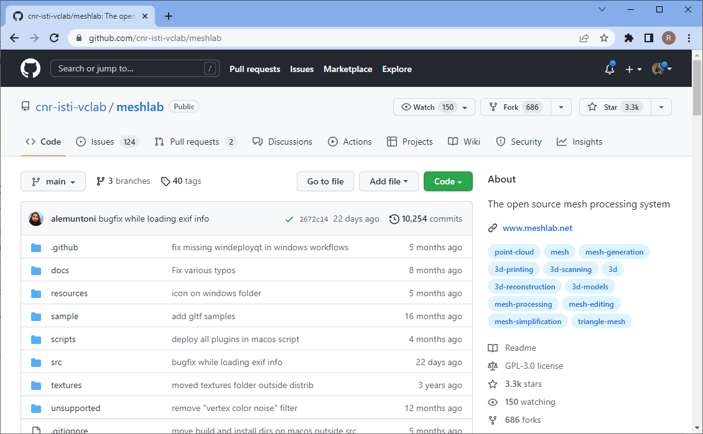
Quiz
May I reuse code from this repository in my own BSD-licensed work?
Yes
No

Slide 71

Quiz
May I reuse code from this repository in my own GPL-licensed work?
Yes
No

Slide 72
Software environments
Robert Haase

Slide 73

git
Version control is key element of data scientist’s toolbox
Distributed file system with sophisticated logging mechanisms
Control about what becomes part of a repository and what not
https://github.com/clEsperanto/pyclesperanto/graphs/contributors

Slide 74
git
Git makes file modifications a more active / involved process (making people think about)
Download remote changes (first time: clone)
Github repository
fetch / pull
My Folder
push
Stage
commit
Upload to the internet
Enter changes in the history, add commit message

Slide 75


git
Who wrote this code
when and
why?
https://github.com/haesleinhuepf/example_image_analysis_script/commits/main/

Slide 76




github – creating repositories
Add a new, empty repository
https://focalplane.biologists.com/2021/09/04/collaborative-bio-image-analysis-script-editing-with-git/

Slide 77


github – clone repositories
git clone https://github.com/organization/repository
Or: Use the Github Desktop app
https://desktop.github.com/

Slide 78



github - uploading
git [add], commit, push

Slide 79

github
Ease of reading notebooks online
No need to download and execute code

Slide 80
git - forking
Making a copy where we have edit rights
Pull-request / merge
repository
(Robert’s)
repository
fork
(Oliver’s)
repository
fork fork
(Peter’s)
fork
fork
Pull-request / merge

Slide 81



github - forking
Making a copy where we have edit rights

Slide 82


github – uploading (again)
After fixing a bug, we upload the changes to our fork

Slide 83


Github – pull requests
Contribute to open-source projects

Slide 84




Github – pull requests
Reviewer perspective

Slide 85
Github – pull requests
Reviewer perspective
Problem solved :-)

Slide 86


Github
If this was too fast…
https://focalplane.biologists.com/2021/09/04/collaborative-bio-image-analysis-script-editing-with-git/

Slide 87

Quiz
It’s ok to reuse this code if …
Mention author
Ask the authors
Link to the license
Copy the copyright statement

Slide 88
Exercises
Robert Haase

Slide 89



Exercises
https://github.com/ScaDS/BIDS-lecture-2024

Slide 90

Exercise (recap)
Make sure mamba is installed on your computer (see instructions from last week)

Slide 91



Exercise (BioImage Archive)
Download a dataset from the BioImage Archive
https://github.com/haesleinhuepf/BIDS-lecture-2024/tree/main/02a_remote_files

Slide 92


Exercise (nextcloud)
Register at Speicherwolke @ Uni Leipzig,
Upload the images from the BioImage Archive to a folder in the Speicherwolke.
https://www.urz.uni-leipzig.de/unsere-services/servicedetail/service/eigener-cloud-speicher-speicherwolke https://www.ebi.ac.uk/bioimage-archive/galleries/S-BIAD634-ai.html https://speicherwolke.uni-leipzig.de/

Slide 93


Exercise (Zendo and DOI)
Explore the DOI and Zenodo APIs to find out the author of online records
https://github.com/haesleinhuepf/BIDS-lecture-2024/tree/main/02b_meta_data

Slide 94


Exercise
Clone the training materials repository
Fix the typo on this page, send a pull-request
https://github.com/haesleinhuepf/BIDS-lecture-2024/blob/main/02c_pull_requests/readme.md

